Slide 1
The EEF NEW School’s Guide to Implementation
Thursday 9th May
Nikki Arkinstall and Stacey Jordan

Slide 2
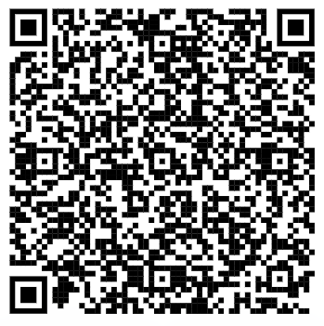
https://shorturl.at/aeyX0
Notes:
We are very excited to be able to share the NEW Implementation Guidance Report
This is going to be a fantastic resource for all school leaders to support them to lead change effectively.
Today will be a walk through of the new report.
We will give you reflection time so you can reflect on the current practice within your own school, organisation or role- whatever you are going to find most useful.
Only going to be able to scratch the surface.
We have created a padlet with all of the resources and the new report, it also includes the old guidance and resources because they are still of value.
New and un expected direction- A new way of conceptualising implementation in schools
Hopefully builds on the strengths of the existing guidance

Slide 3
Session Overview
1
Introduction to the EEF and Staffordshire Research School
2
Introduce the Key Ideas in the New Guidance Report
3
Reflect and Plan
4
Further Opportunities
Notes:
Introduce the key ideas in the guidance report
Might have had a chance to read it
What has and has not changed
Learn a narrative to introduce it to colleagues
Initial thoughts and reflections
Information – digest it
If you have read it – what are your main takeaways from the new guidance report?

Slide 4
Notes:
Nikki
To support teachers and school leaders in tackling this challenge, the EEF takes a three-pronged approach:
Evidence generation: We commission robust studies of educational programmes in order to assess their actual impact on pupil progress. Many initiatives make bold claims around improving outcomes – our independent evaluations present findings teachers can trust when deciding whether to invest in a new approach.
Evidence synthesis: The EEF also regularly reviews the existing research base, drawing out findings from other robust studies so that teachers and school leaders can access information about teaching and learning approaches that have proven effective in other classrooms.
Evidence mobilisation: We recognise that producing and summarising research is not enough to support behaviour change in the system. We work to bring the evidence to meet busy teachers and school leaders where they are, producing resources which make research findings more accessible, such as our guidance reports, and providing on the ground support for schools through our Research Schools Network.

Slide 5
Staffordshire Research School
Evidence Leads in Education
ELEs
Hannah Hall
Behaviour & SEND
Jade Pearce
Cognitive Science
Matt Winzor
Behaviour & Disadvantage
Will Allen
Behaviour & Disadvantage
Pam Carpenter
Social & Emotional Learning
Jez Baker Implementation & PD
Amy Husband – Inspire ET
Megan Scullion – Romero MAC
Juliet Stafford – Etone, Matrix MAT
Notes:
Introduce core team
ELEs
You may see a range of faces delivering CPD sessions throughout the year.

Slide 6
Exemplification
Notes:
You tube channel, website and podcast.

Slide 7
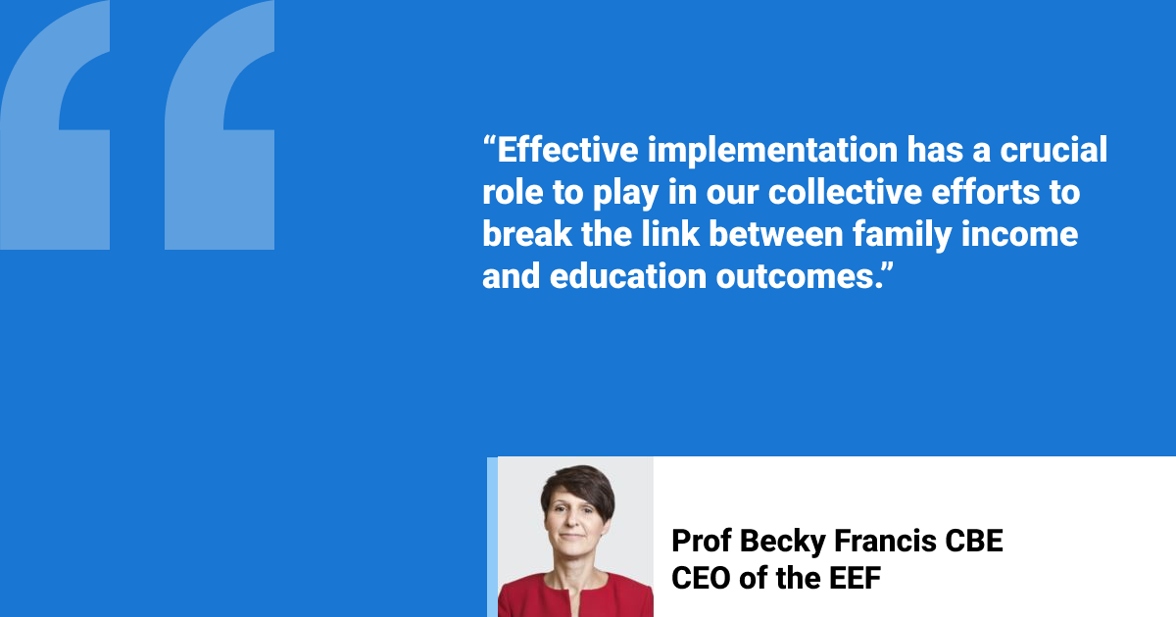
“Our leaders are more evidence-rich than a decade ago. But leaders face a clear choice about the ways in which they use it.
Ironically, as the language of evidence proliferates, there is a risk that it loses its impact. Surface-level compliance is the biggest threat to any change in education.”
Prof. Becky Francis
Chief Executive
Education Endowment Foundation
Notes:
IMPLEMENTATION MATTERS
A culture shift is occurring in English schools towards widespread engagement with research, with evidence-based resources becoming go-to sources of guidance. Our education system is one of the most research engaged in the world
Yet, awareness of evidence does not necessarily result in improved outcomes: implementation is critical for turning that interest and engagement with research into tangible changes in school practices and pupil outcomes, including, crucially for pupils facing socio-economic disadvantage. Implementation matters.
As evidence use becomes woven into the system, we face a choice about where we go next, and whether we collectively want to turn the widespread awareness of research into meaningful changes in practice.
Moment in time for evidence engagement
There has been a culture shift in the last ten years
Evidence is now being baked into the system
Interest in research has changed phenomenally
Now we need to move forward making sure it is not just superficial

Slide 8
The quality of implementation matters
“There is substantial evidence indicating that, when implemented well, the effectiveness of school-based programmes increases in terms of pupil outcomes”
= ‘Treat implementation as a process’
Update = How to do that process well
Notes:
Refocusing on the quality
Quote from guidance
QUALITY OF IMPLEMENTATION MATTERS
The new guidance report is based on an extensive review of evidence on Implementation in Schools. Largest ever conducted on this topic.
Encouragingly, it shows that implementation matters: that when implemented well, the effectiveness of school-based programmes increases in terms of pupil outcomes.
The key phrase here is when implemented well (animate).The new guidance focuses on what enables effective implementation in schools.
If the take-away message in the first version was ‘treat implementation as a process’, now we are focusing how to do that process well. Introducing a conversation around quality.
Key word – well
The message has been so far – treat it as a process
Keep that going
How do we do that process well
What drives quality implementation ?
How do we do it well.

Slide 9
Implementation is fundamentally a collaborative and social process driven by how people think, behave, and interact.
Notes:
PEOPLE DRIVE EFFECTIVE IMPLEMENTATION
And at the heart of what drives effective implementation are people. The evidence shows that implementation is fundamentally a collaborative and social process driven by how people think, behave, and interact.
Implementing change in a school involves coordinating the actions of hundreds of people, each with their own habits, beliefs, knowledge and skills etc – it’s tricky!
In this report there is a real emphasis on people
Driven by people and how they interact and behave
The other report did not mention the social aspect of change
This report draws it to the surface
People are what drive quality implementation

Slide 10
Notes:
Lot of work
The largest review of implementation in schools ever conducted
Large systematic review
293 papers included
Colossal piece of work
Huge undertaking
Actual review is 600 pages long
Wealth of insight
Body of evidence

Slide 11
Notes:
This guidance report is based on an extensive review of evidence on implementation in schools (see Summary of Evidence section).7 This guidance sets out three key elements that enable effective implementation in schools, which comprise the main sections of the report:
These three elements work together (see Figure 1). The behaviours and contextual factors underpin effective implementation and should infuse your day to day work. The process helps schools navigate change and organise implementation into manageable phases: Explore, Prepare, Deliver, and Sustain.
the behaviours that drive effective implementation (see Recommendation 1);
the contextual factors that influence implementation (see Recommendation 2); and
a structured, but flexible, process to enact implementation (see Recommendation 3).
In other words, the process helps schools do implementation. The behaviours and contextual factors help them do it well

Slide 12
Recommendation 1
Adopt the behaviours that drive effective implementation
Notes:
There are three main recommendation in the guidance report. The first focuses on the behaviours that drive effective implementation.
The first recommendation is on these behaviours that drive effective implementation
New thing that came out of the review
The existing process – notable The absence of talking about people and how they interact the role of people
Lots of things to do but it misses out the people
The way in which people behave and interact is at the heart of how people view implementation
Evidence in how people think – is at the heart of what drives effective implementation

Slide 13
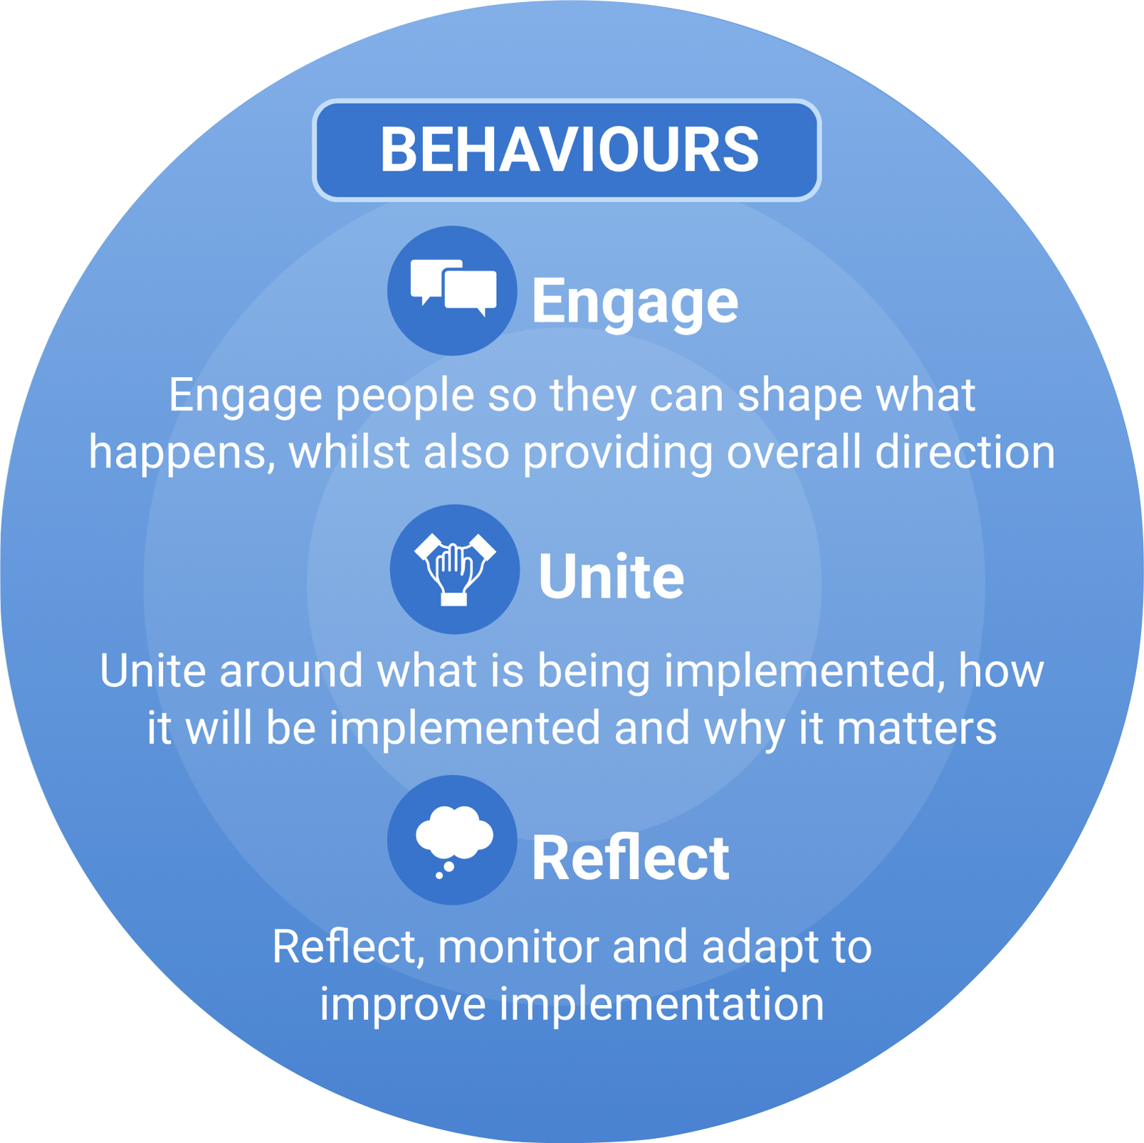
Recommendation 1 Adopt the behaviours that drive effective implementation
Three cross-cutting behaviours get to the heart of what drives effective implementation.
Should feature across all implementation strategies and actions.
Notes:
THE BEHAVIOURS THAT DRIVE IMPLEMENTATION
The review and guidance identifies three cross-cutting behaviours that drives effective implementation - engage, unite, reflect.
These behaviours get to heart of what drives effective implementation and should permeate all implementation strategies and actions (to various degrees)
While the terms ‘engage’, ‘reflect’, and ‘unite’ may be familiar to schools, they mean something specific in the context of implementation. There are various dimensions to each behaviour and it’s worth taking time to understand them fully.
Also, whilst these cross-cutting behaviours sound like common sense they are difficult to get right in practice – ‘uncommon common sense’
Let’s take a closer look….
Three cross cutting behaviours
Engage
Unite
Reflect
Feel that if you can deeply understand these and get them infused into your implementation activity you are in a good place to make implementation happen well
How you can get them to feature across all your actins – wont all apply – some time more than others
Need to be infused in everything you do
Risk that these terms – because they are familiar words – they mean something specific in implementation – they mean something – details matter in these behaviours
Easy to say but hard to do
They sound sensible but we don’t do them
They are hard to enact and embed into what is happening
Challenge the complacency – if engaged with superficially
Need to get under the skin of them
Uncommon common sense stuff
Don’t do them

Slide 14
Evidence suggests that implementation improves when schools:
ENGAGE
UNITE
REFLECT
Engage people so they can shape what happens while also providing overall direction
Unite peoples around what is being implemented, how it will be implemented, and why it matters
Reflect, monitor and adapt to improve implementation
Notes:
Unite
Beating heart
Traced to different beliefs and beliefs
What is happening and why
Tools to unite understanding but will only impact if people are involved in it
Reflect
Evidence informed implementation
Reflective engine that drives that
Reflecting on priorities barriers and enablers
As it is happening so you can improve it over time
Behaviours should be infused into our work
Easy to say but hard to do
Mean something specific
Hard to get going well
TA deployment - engage people across the school. Take everyone with you
Problem not doing that

Slide 15
Adopt the behaviours that drive effective implementation
“When the school community feels included in decisions that affect them, then implementation is likely to improve. People, ultimately, value what they feel part of.”
ENGAGE
Engage people so they can shape what happens while also providing overall direction
Notes:
ENGAGE
The way in which people are involved in implementation and the quality of their interactions really matters. Three dimensions to effective engagement within implementation:
Engage people so they have the potential to influence change - Provide meaningful opportunities for people to share perspectives, ideas, and concerns. Extends to students, families.
Engage people in collaborative processes – Create ways for people to work together to bounce ideas and insights, solve problems collaboratively etc. Structures like implementation teams can be useful in this respect.
Summarise first two points: when the school community feels included in decisions that affect them, then implementation is likely to improve. People, ultimately, value what they feel part of.
Engage people through clear communication and active guidance – Whilst we want these participatory ways of engaging people, implementation also needs actively guiding and steering – this involves leaders communicating the direction of travel, explaining decisions, corralling efforts, and preventing implementation being dragged off track
Engage
The way in which people are involved and how they are brought into it
That really matters
Three dimensions
Engage
Way people are engaged implementation really matters
People needs to be engaged in that they can shape what happens
Feed into it in active way
People value what they feel a part of
Pupils and parents
Implementation teams
Professional learning communities
Solve problems together
Make intention happen
Directive
Communicating
Motivating
Curating efforts
Dedicated but distributive leadership
Engaging people in such a way that they have the potential to influense what is going on
Was called voices – giving people a voice in implementation
See quote
We need to create meaningful opportunities for staff to share perspectives provide insights of what is going on
Share their concerns, contribute to the change , give their opinion
Need that to understand implementation
Secondary effect – people feel more bought into it
Extends to pupils and families – strong evidence
2
Engaging in collaborative processe s
Implemetation teams
Collaboarative discussions
Enacle to share bounce ideas insights solve problems collaboratively
3
Guide and steer
Clear communication and direction to set out what is expected
What is going on
Clear expression of it being a priotirty from leadership
Motivating
Keeping it o track
Sits alongside
Compleents participatory ways of enaggig

Slide 16
Adopt the behaviours that drive effective implementation
“Poor implementation can often be traced to differing values, understanding, and practices among staff. This incoherence creates ambiguity, meaning colleagues can appear as though they are on the same page when they are not.”
UNITE
Unite peoples around what is being implemented, how it will be implemented, and why it matters
Notes:
UNITE
The next cross-cutting behaviour is unite:
As the guidance says, “Poor implementation can often be traced to differing values, understanding, and practices among staff. This ambiguity means colleagues can appear as though they are on the same page when they are not.”
Actions that align and unite people are therefore a key driver of effective implementation. There are a range of things to unite around, from overarching visions and values to the specific practices that result from implementing a new approach:
Unite values – If an approach doesn’t align with people’s values, they are less likely to implement it. By exploring common goals, acknowledging and addressing concerns, and discussing the risks and benefits of taking action, implementation leaders can help unite values and improve buy-in.
Unite knowledge and understanding - While shared values lay the foundation for successful implementation, schools also need to cohere around what those values and principles look like in practice. This means moving beyond a ‘shared vision’ to develop a shared understanding of what is being implemented, how it will be implemented, and why it matters
Unite skills and techniques - Uniting within implementation also includes uniting the skills and practical techniques that relate to a new approach, for example, through ongoing professional development
Unite implementation process - Finally, uniting extends to the values and practices that relate to the process of implementation itself. For example, developing a shared belief that monitoring implementation is key to enabling ongoing improvement, rather than playing a punitive accountability, can fundamentally change how staff feel about implementation. Leaders and staff should explicitly discuss how implementation is conducted in the school and how it can be improved
2nd behaviour is unite
Quote sets the scence
Various activities to build shared understanding
Unite
Beating heart
Traced to different beliefs and beliefs
What is happening and why
Tools to unite understanding but will only impact if people are involved in it
Uniting around a variety of things
Uniting values and vision
Peoples values around change will really influence iimplmentation
Shared culture
This is missing
Limit to how much you can change values
Research shows that it can be changed – through discussions, questions, addressing concerns, talking exploring goals
TA – different values – can be underpinned by concerns – workload etc.
Discussion can address the values
Developing shared values and vision is necessary ut not sufficnet
To move on from that have to get a shared understanding of what is going on

Slide 17
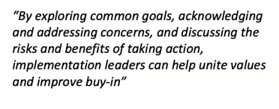
Notes:
BUILDING SHARED UNDERSTANDING IS HARD
This tweet, discussing implementing a new curriculum in schools in New York, shows the challenge schools and systems leaders face in ‘getting on the same page’ when implementing
Strategies like implementation planning can be really useful in building shared understanding (on the why, what, how etc) but only if people are actively. Planning in isolation won’t unite understanding – the process is more important than the output
We have been asked to start something without knowing what it is
See that again
Head into a change without people knowing what is happening, why and what is expected
Where implantation planning can be really helpful here can play a valuable role in a tool to create shared understanding play a vauable role
How you do it is more important than the plan
If you are doing it without warning and discussing it
Emphasises how you do it = need to engage and unite or it will not have an impact
How you do it is more important than creating a plan
The purpose of planning is to unite staff or it will not have an impact

Slide 18
Adopt the behaviours that drive effective implementation
“A theme across this guidance report is that evidence and data should inform all aspects of implementation, both what to implement and how. Reflection underpins evidence-informed decision-making within implementation.”
REFLECT
Reflect, monitor and adapt to improve implementation
Notes:
REFLECT
The final behavioural driver is ‘reflect’:
A theme across this guidance report is that evidence and data should inform all aspects of implementation, both what to implement and how.
Reflection underpins evidence-informed decision-making within implementation.
It enables ongoing learning and improvement.
Reflecting the final one
Thee
Evidence and data should inform all aspects of implementation
Reflection underpins evidence informed decision making in implementation
Reflect on many things in an ongoing way
Pupil needs
Current practices
Fit and feasibility
Barriers and enablers
Progress through monitoring
2 dimensions
1 structured processes that enable reflection –monitoring processes
2 individual responsibility – leaders are adopting a reflective outlook – being ready to review practice
Individuals, staff and leaders – being keen and ready to review and refine their practice
What to implement and how to implement

Slide 19
Notes:
REFLECT:
If schools are implementing effectively, they will be reflecting on a range of things in an ongoing way: pupil needs, current practices, fit and feasibility of possible new approaches, implementation problems and successes
Requires structures processes at an organisation level (e.g. to monitor implementation), as well as individuals having a reflective outlook where they review and refine their own practice

Slide 20
Reflections and Action Planning

Slide 21
Recommendation 2
Attend to the contextual factors that influence implementation
Notes:
The second recommendations outlines the contextual factors that influence implementation

Slide 22
The behaviours are influenced by the contexts in which implementation happens.
These contextual factors can be enabling or constraining...
Time to meet
Availability of monitoring system
Notes:
CONTEXTUAL FACTORS THAT INFLUENCE IMPLEMENTATION
The behaviours that underpin effective implementation are influenced by the contexts in which implementation happens. These contextual factors can be enabling or constraining...
For example, it is hard to unite understanding through implementation planning if there isn’t time to meet and discuss plans; reflecting on implementation progress is tricky if there isn’t a system in place to monitor implementation

Slide 23
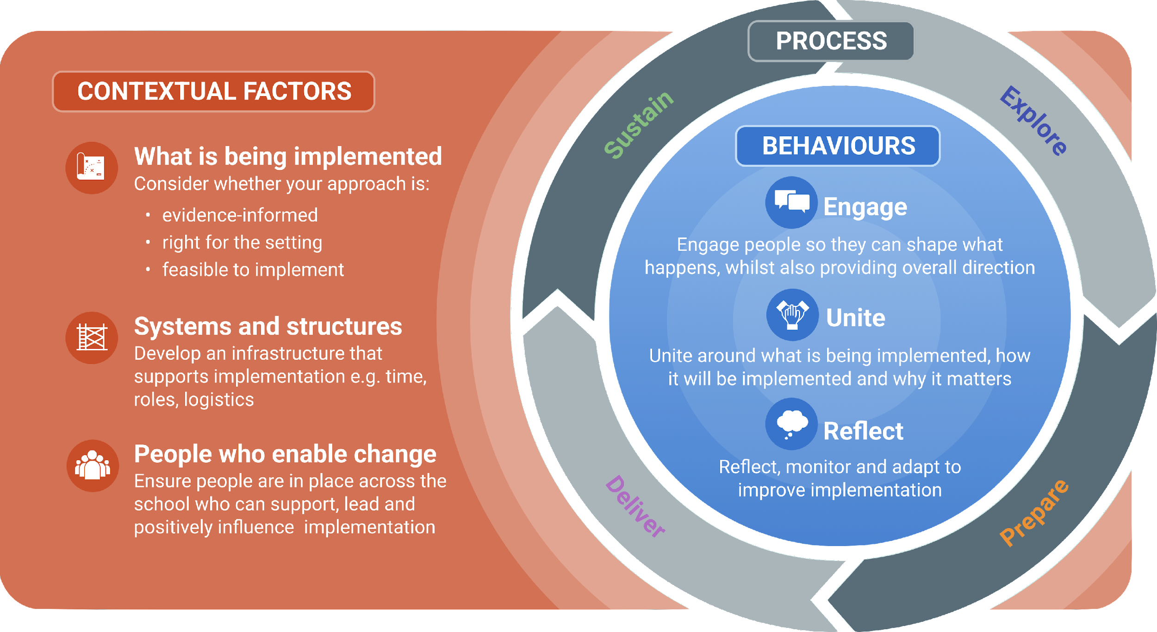
Recommendation 2 Attend to the contextual factors that influence implementation
Notes:
THE CONTEXTUAL FACTORS THAT INFLUENCE IMPLEMENTATION
And the guidance outlines three contextual factors that influence implementation: what is being implemented, systems and structures, and people who enable change.
Let’s have a look at them…
Think of the behaviours the key driver however they don’t happen in a vacuum
The context in which you are operating influences what you are able to implement in school
A wide variety of factors influence that
The nature of the review aiming to look at
What are the contextual factors that support or hinder implementation
What ways do they work
The contextual factors underpin the behaviours we mentioned earlier
The presence and attending to the contextual factors would facilitate and influence the different behaviours which will allow you to achieve your implementations outcomes
What is being implemented – if the approach is evidence informed and suitable for the setting and feasible for it to be implemented
Systems and structures - Infrastructure available – allowing you to support implementation – internal or external influences
People – who will be enabling change and supporting the implementation process

Slide 24
Attend to the contextual factors that influence implementation:
“It is all too easy to ‘dream big’ when thinking about implementing a new programme or practice and overlook the structural conditions that make that possible.”
SYSTEMS AND STRUCTURES
Develop an infrastructure that supports implementation e.g. time, roles, logistics
Notes:
SYSTEMS AND STRUCTURES
As the guidance says, “It is all too easy to ‘dream big’ when thinking about implementing a new programme or practice and overlook the structural conditions that make that possible.
Systems and structure refers to the infrastructure that is needed to support implementation. Allow people to enact the behaviours that drive implementation.
The infrastructure
Quote – dream big
If done well you would not notice them in schools
Allow things to go smoothly
External and internal structures
Such as time and roles
If done well smoothly will allow the implementation process to be done well
Key systems and structures
Internal and external
School structures – timetables, logistics, process, policies, time allocated to meetings and activities
Policies

Slide 25
Systems and structures operate both within the school and externally, including:
school structures e.g. timetables;
logistics and processes e.g. data monitoring systems;
resources e.g. funding and equipment;
time e.g. allocating meeting time;
policies e.g. MAT, local, or national policies; and
roles e.g. implementation teams.
Notes:
SYSTEMS AND STRUCTURE COVER A RANGE OF THINGS
Covers a range of systems and structures that operate both within the school and externally:
school structures e.g. timetables;
logistics and processes e.g. data monitoring systems;
resources e.g. funding and equipment;time e.g. allocating meeting time;
policies e.g. MAT, local, or national policies; and
roles e.g. implementation teams.
Aim to repurpose existing systems and structures rather than bolting on new ones
Be aware that some structural factors are less controllable than others yet can still influence implementation—for example, national or regional policies.

Slide 26
Attend to the contextual factors that influence implementation:
“The second contextual factor is whether there is a range of people who can lead and support the changes. This can include senior leaders, implementation teams, early adopters, student representatives, and support staff, among others.”
PEOPLE WHO ENABLE CHANGE
Ensure people are in place who can support, lead, and positively influence implementation
Notes:
PEOPLE WHO ENABLE CHANGE
The second contextual factor is whether there is a range of people who can lead and support the changes. T
This includes implementation leaders (school leaders, subject leads) but should be broader than that: ‘People who enable change’ can be implementation teams, champions, early adopters, student representatives, and support staff, among others.
Distributing leadership and support has a number of advantages: it shares the burden of managing change, naturally brings in different perspectives and expertise, and builds resilience, as implementation becomes less reliant on specific individuals.
The factors that influence whether an individual or group can support implementation include whether
they have the knowledge, skills, and expertise to help implement the approach
they feel empowered to act and can empower others; and
they have agency—choice over actions—within their remit
School and implementation leaders should actively consider whether enough skilled and empowered people are available who can support implementation
People who enable change
Who do I have in the tea who will help me to implement this and drive the change with me
This is key
Who will help you to enable change
Could be misinterpreted as SLT
Can be anyone in the school community
Do we have the right people with the right knowledge and skills and feel impowered to drive change
Who can engage others to the new implementation effort
Overlap of behaviours
Engage – empowered, skills, values, knowledge – will help to engage the rest of the school community to help untie everyone to the task that needs to be impleneted.

Slide 27
Attend to the contextual factors that influence implementation:
“The features of an intervention impact on how it will be implemented. For example, if an approach is well specified, it will be easier to implement than if it is vaguely defined”
WHAT IS BEING IMPLEMENTED
Consider whether the approach is:
evidence-informed
right for the setting
feasible to implement
Notes:
WHAT IS BEING IMPLEMENTED
The final contextual factor is slightly different, in that it is the approach itself that is being implemented
But if you think about it that makes sense, as the features of an intervention impact on how it will be implemented.
For example, a complex whole school intervention, with multiple elements and lots of people, is likely to be harder to implement than a simple 1-2-1 reading intervention
Equally, if an approach is well specified, it will be easier to unite understanding and practices than if it is vaguely defined
It also influences the systems and structures that are needed and people who enable chang
Schools therefore need to consider the features and requirements of ‘what is being implemented’ and design implementation accordingly.
They should be looking for approaches that are evidence-informed, right for the setting and feasible to implement. A process for selecting appropriate evidence-informed approaches is provided in the Explore section.
Previous report did not talk about what is being implemented
Key update
What is being
It was implicit – it did not explicitly talk about what is being implemented
This is now emphasised in the new report
Evidence shows that - The features of an approach or intervention impact on how it will be implemented
If it is a strategy that is well specified it will be easier to be implemented
The complexity of the approach will influence how it is implemented
It will influence the ability to engage people or unite the values around what will be implemented
Is the approach Evidence informed- is the evidence robust enough- teaching and learning toolkit
Is it right for the setting – will it address the pupil needs of the organisation? That we are trying to address
Is it feasible to be implemented in my context – we will be looking at this in greater detail in recommendation 3 when we explore the process

Slide 28
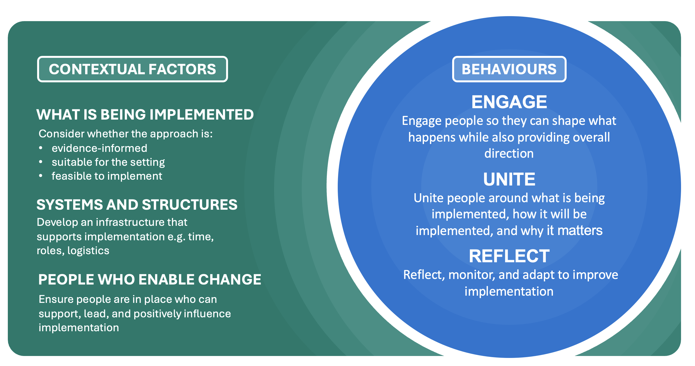
Reflections and Action Planning

Slide 29
On their own, these factors can be hard to enact – need a structured process . . .

Slide 30
On their own, these factors can be hard to enact – need a structured process . . .

Slide 31
Recommendation 3
Adopt a structured but flexible implementation process

Slide 32
Notes:
Recommendation 3
Start by what has changed
Current process on left – new on right
It is now a single recommendation
One on behaviours, context and then process where before each step of process was a recommendation
Familiar but different
The first one has a lot more steps and more detailed- linear steps
New version - Broader headings
The guidance unpacks the detail – reasons for this – recommendations added 1 + 2 manage cognitive load
Cognitive load removed from the diagram to avoid overload and not overwhelm
Strategies remain in their phase on left – have not got a flexible process – what starts in explore stays in explore
In new version – strategies can extend and overlap and be extended
Example – revisit pupil needs –strong reason to revisit needs - are there emerging needs as we go on
Things may begin in explore phase but will need to be revisited later on as implementation progresses.
Arrows indicate things may need to be revisited
Implementation planning – good reason to revist as it progresses
Left – directive sequence – the process was the guidance – there were foundations but the bulk was process
It was not responsive to setting – follow these steps
Good job in thinking about implementation and the language
Implementation needs to be more flexible, responsive and adaptive to what is happening the setting
Complex system – not predicitble – things change
Lighten the snse of directive steps and show it is fluid and responsive
Operationalise the behaviours and contextual factors – which was not apart of the previous guidance at all
Different users –Think of a world where - if you deeply understood the behaviours and context that drive implementation you may not need the process if you internalise that
Value as having this scaffolding processes less directive process
Helping to manage and organise Implementation
Different schools, different understanding

Slide 33
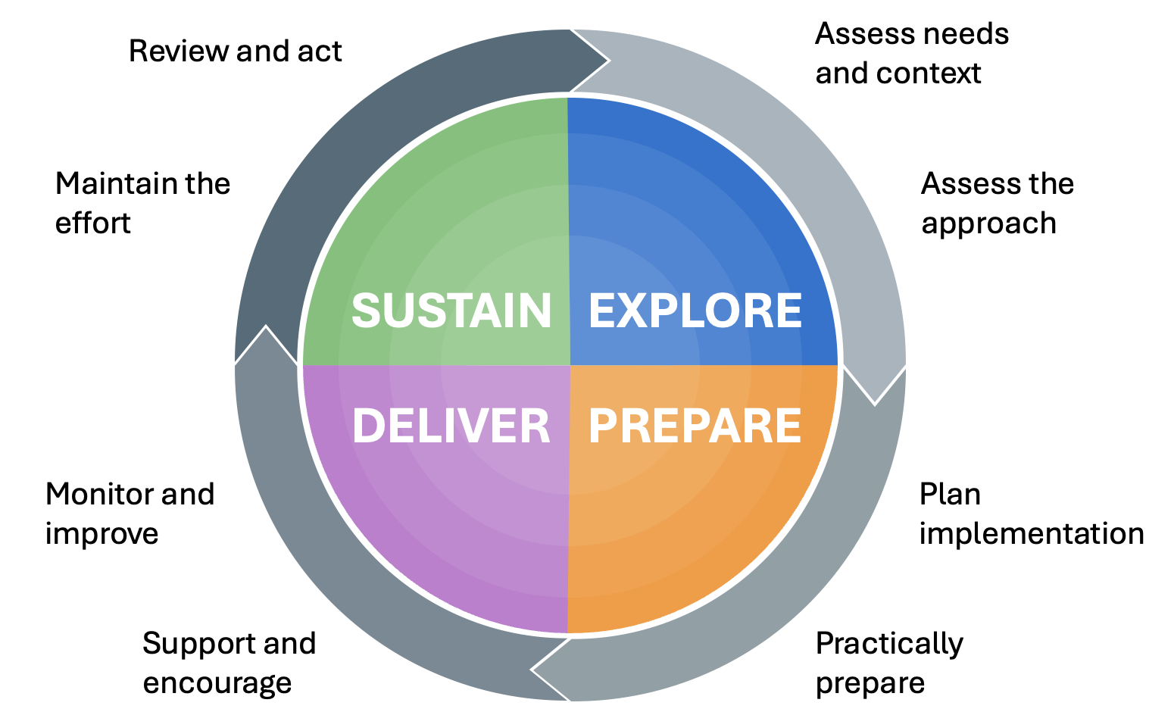
”Implementation doesn't occur in a neat and linear fashion: strategies and phases overlap and are revisited over time.
As such, implementation is best treated as a process of ongoing learning that adapts to the changing needs of the school."
Notes:
A STRUCTURED YET FLEXIBLE PROCESS
Key message – We have retained the phased process, but it is more flexible and responsive to setting and needs – hence a scaffold, not a step-by-step sequence
The updated graphic is meant to convey the idea that the process is 'familiar but different'

Slide 34
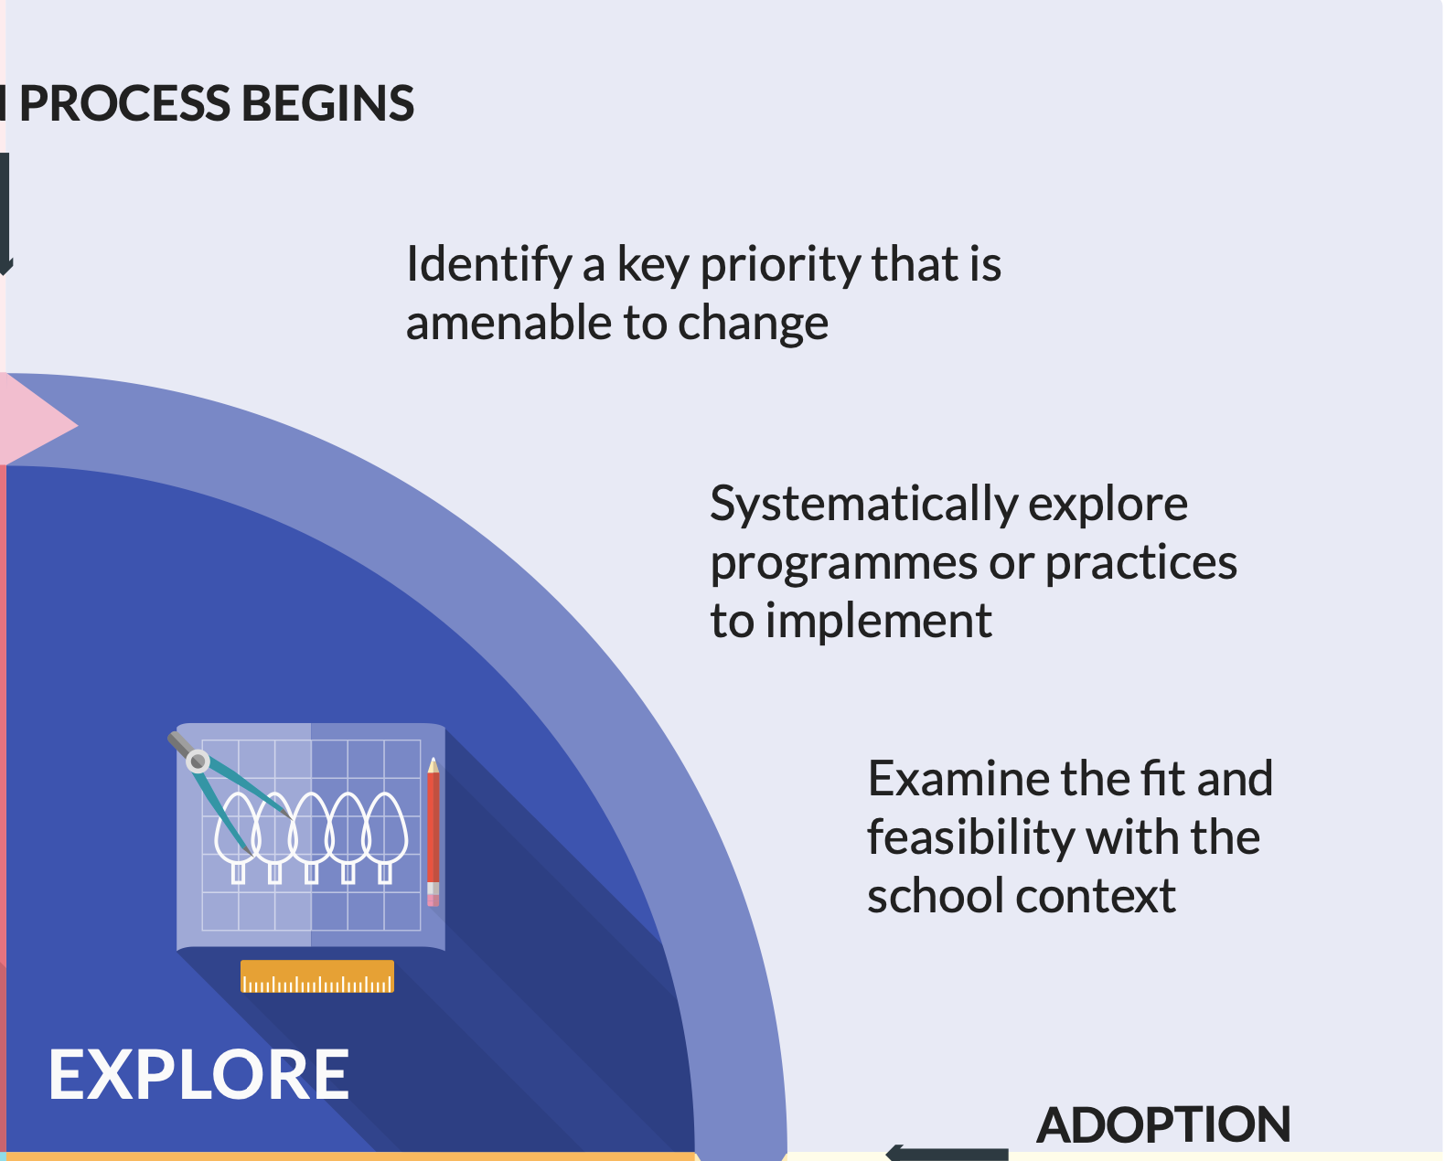
The Explore phase - a ‘conversation’, not a sequence
Notes:
EXPLORE PHASE IS A GOOD EXAMPLE OF THAT
The previous version of the guidance perhaps gave the impression that the Explore phase was quite linear and step-by-step.
The new Explore phase emphasises flexibility and a more dynamic conversation between considering pupil needs, the school setting and the evidence, not a step-by-step process. It provides manageable engagement with complexity
Explore phase
Conversation not a sequence
Need and evidence rather than a step by step sequence
Hammer analogy from earlier
Priority then look at evidence – more fluid than that
Centred around two key questions

Slide 35
Now centred around two questions
1
Right for our setting?
Notes:
The new Explore phase is centred around two questions. First, is the approach we are considering 'right for our setting'?

Slide 36
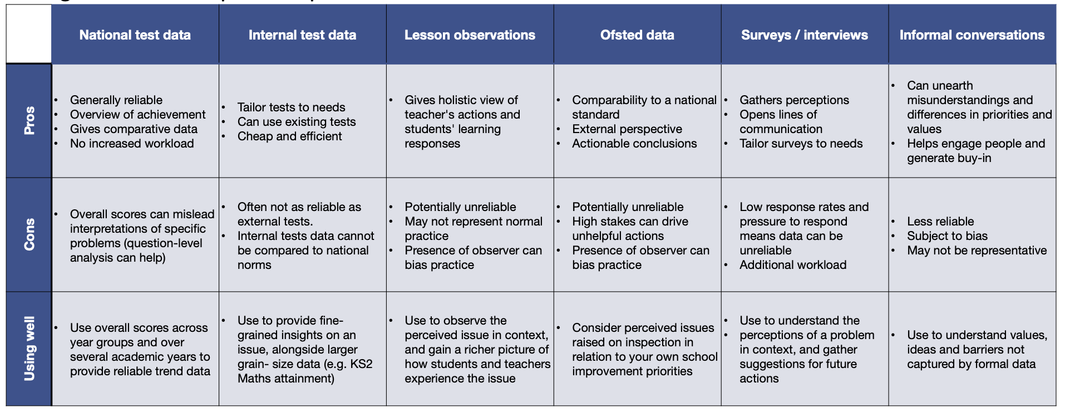
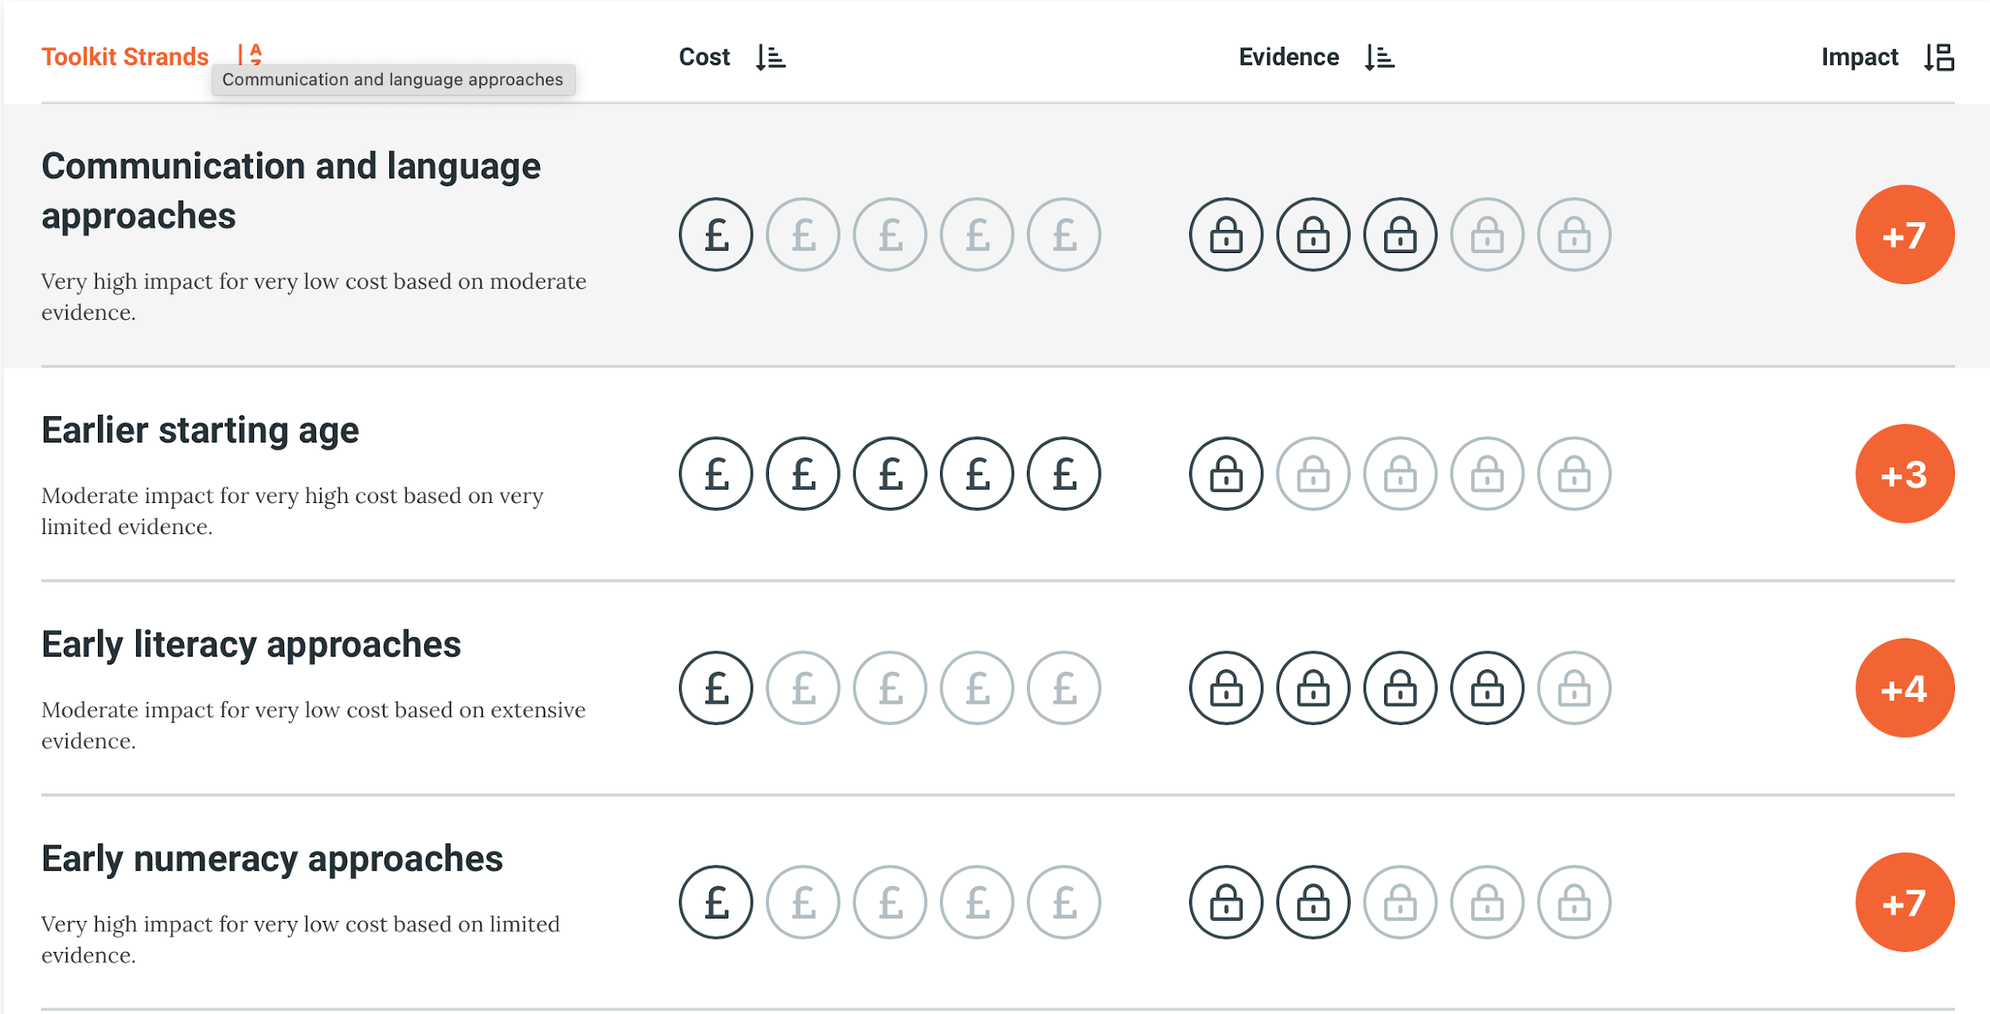
Now centred around two questions
What’s the problem and what’s already going on?
Identify pupil needs and their root causes
Understand current practices and what influences them
1
What does the research evidence suggest and how does it relate to our setting?
Consider research evidence about what has worked elsewhere
Consider how well the approach addresses the problem and fits our setting
1
Right for our setting?
Right for our setting?
Notes:
IS AN APPROACH/INTERVENTION POTENTIALLY RIGHT FOR OUR SETTING?
To answer this first question, we firstly need to know our pupil needs and their root causes. As previously, this involves looking at a range of data sources and acknowledging their relative strengths and weaknesses (table animates in).
But it also involves looking at what's already going on in relation to those needs. For example, if we've identified a problem with reading, we should also look at what's already going on in terms of reading – are there existing approaches in place? How are teachers routinely dealing with reading?
At the same time, we should also be engaging with evidence that is relevant to our pupil needs. This will involve looking at sources such as the T&L Toolkit, guidance reports, and so on. The recently published Using Research Evidence guide is helpful here.
Considering the evidence helps us determine what needs to change and whether a new approach is likely to meet our pupils' needs and be better than what's already going on.
Is this suitable for our setting
1 what is the problem
2 what is already going on- new and nuanced addition – more attention to what is already going on – really important – will come back to that in a moment.
Right - Looking at the research evidence and how it relates to our setting – direct schools towards - treahcing and learning toolkit anfd guidance report to find out what has worked in other settings – but the important question – is it suitable for our setting – does that evidence address the problems we are facing
Is it likely to be better than what is already happening can oly answer this if look at what is happening
How does it align to the evidence
What needs to change
Whether a new approach will be better than the status quo
Behaviours are crucial in this process need to engage people in looking at the problem
Reading need – what is currently going on – interventions, what is happening in classrooms – how doe this align to evidence. What needs to change
We talk about this in the current guidance and PP guidance – pupil needs before doing anything

Slide 37
Notes:
The behaviours are crucial in this process
It is about how well we do this
Engage people in understanding the problem looking at the evidence
Evidence shows that if we engage people in this that is what drive process it drives quality implementation
Key role in uniting people around why we are making changes
What problem are we addressing
What evidence shows about what is more beneficial
Really imporntatn thet Behaviours drive prcess and mae it a quality oprcess
Hwat is happening – contextual facots
If teachers are using existing practices it may be becayse of context ual facote
Systems and structures in place – resources, systems, schemes of work that reinforce ways of working
Complex system – has a role in how people behave - infrastructure
More subtle and sophisticated way to look at needs and research in our settings

Slide 38
Now centred around two questions
What’s the problem and what’s already going on?
Identify pupil needs and their root causes
Understand current practices and what influences them
1
What does the research evidence suggest and how does it relate to our setting?
Consider research evidence about what has worked elsewhere
Consider how well the approach addresses the problem and fits our setting
1
Right for our setting?
Right for our setting?
What are the barriers and enablers to change in our setting?
Consider what will help or hinder implementation in the school e.g. time to engage, existing skills and expertise
2
How challenging is the approach to implement?
Consider how implementation may be enabled or constrained by the features of the approach e.g. degree of complexity, quality of professional development, availability of resources
Feasible to implement?
Notes:
THE EXPLORE TOOL
This tool is the Explore phase. As you can see, it is about matching an evidence-informed approach to our pupil needs and setting (the two columns). Again, this is about structuring a manageable engagement with complexity.
(Note to Research Schools: although each of the two central questions involve moving back and forth between different considerations, we recommend talking it though in a clockwise fashion.)

Slide 39
The resulting tool is the Explore phase
Assess needs and setting
Assess approach
What’s the problem and what’s already going on?
Identify pupil needs and their root causes
Understand current practices and what influences them
1
What does the research evidence suggest and how does it relate to our setting?
Consider research evidence about what has worked elsewhere
Consider how well the approach addresses the problem and fits our setting
1
Right for our setting?
Right for our setting?
What are the barriers and enablers to change in our setting?
Consider what will help or hinder implementation in the school e.g. time to engage, existing skills and expertise
2
How challenging is the approach to implement?
Consider how implementation may be enabled or constrained by the features of the approach e.g. degree of complexity, quality of professional development, availability of resources
Feasible to implement?
Notes:
THE EXPLORE TOOL
This tool is the Explore phase. As you can see, it is about matching an evidence-informed approach to our pupil needs and setting (the two columns). Again, this is about structuring a manageable engagement with complexity.
(Note to Research Schools: although each of the two central questions involve moving back and forth between different considerations, we recommend talking it though in a clockwise fashion.)
Second question
Is it feasible in our setting
Two questions
Work round in a clockwise – start with the problem - way but they all relate
Conversation
How challenging is it to implement - When we look at the evidence we need to look at it and see what it involves – CPD – how many hours, people, how much resources, is it complex or not
Left - Barriers and enablers and what role they play in driving implementation
Good example of comething that Starts in explore and then carries on
Barrier – then we can look at or context – we don’t have time or expertise – may also barriers emerge during imenetikn
What engaging and reflecting with people throught is important – tro identify new barriers
The tool is the new explore phase
Much more structured
Fluid process
Draws on a range of evidence and implementation strategies – needs assement ext
Guides them through complexity – want them to be subyoe
How what is happening in classrooms is driven through context in a manageable way
Every phase – checklist quesiotns at the end in place

Slide 41
Prepare
Plan and design
plan implementation (collaboratively)
monitor implementation (unite on why monitoring)
Practically prepare
select implementation strategies
…. including Professional Development
build systems and structures
clear leadership communication
Notes:
PREPARE
The Prepare phase is divided into two overarching implementation strategies (each is actually an aggregation of multiple strategies) : 'Plan and design' and 'Practically prepare'
'Plan and design' includes:
a thorough walkthrough of implementation planning, and how to do it well – which, as mentioned previously, means engaging people and seeing planning as an opportunity to unite people around the changes. Note here that we've changed the term 'active ingredients' to the more intuitive 'core components' - the meaning is the same
designing a monitoring system – which includes the importance of uniting people around why monitoring is happening (i.e. to drive improvement and unearth potential barriers)
We also unpack implementation outcomes in more deateil and stress the importance of monitoring and ensuring a range of implementation outcomes
'Practically prepare' includes:
selecting implementation strategies - there is greater emphasis on selecting implementation strategies in response to needs and setting
one such strategy is Professional development – we link to the PD guidance – and its role in uniting people around, for example, the core components of the approach (don’t just train and pray though!)
developing the systems and structures that will be required to support the changes
the importance of ongoing leadership communication (the directive and guiding part of 'engage')
Prepare phase
There is a section on implementation planning and how to do it well
Much more structured walk through of each section of the implemention plan
Core compenents and what they are
Weave in the behavoirs throughout the implementation planning and how to do it well
Not just impentation planning but Dong it well
Unite people about why the change needs to be made
What the intervention entails
How it is implemneted
How well it is going
What the objectives are
Blue box – call outs – not the plan but the process and engaging stakeholders in discussion
Use planning to unite people around what is happening and to engage them in implementation
Unite values
Monitoring
Is important
Key ways to understand emerging barriers
What is going well and where need further support
One of things evidence strongly suggests where monritong goes wrong – faiing to unite pople about whay it is happening
Not making judgements , not accountability measure – we want to understand how we can make this approach better
Know why it is being done
Voce about what data is collected and how it is shared
Learning process
enaged in the process voice in shaping how momnitoring is carrei dout
Get an opportunity to reflect on it and shre theie views insights
Behavuours punching through and contect punching throufh process
Tale it out and get a less efeective model of implementation
Signpost to PD guidance – key part of preparation – not done in the last guidance report
It is now
Key part of preparation
Talk about implementation strategies
At end – table of extended strategies – expanded list
Reinforces message – flexible and meeting context
In response to barriers we have identified are there additional strategies we could use for our context – more flexible and responsive
Explicitly develop systems and structures
Monitoring systems
How information in shared
Importance of leadership and communication
Clarity about what is happening what is expected what will be supported
Leadership knowledge – when it fails because leaders do not have a robust understanding of what is happening what the intervention entails and why
Not Underestimating PD for themselves as well

Slide 43
Deliver
“When delivery is framed as a learning process, monitoring implementation becomes an essential tool in identifying, and acting on, implementation problems.”
DELIVER
Support and encourage
Support staff during initial implementation efforts
Provide prompts and reminders
Reinforce professional development
Monitor and improve
Use monitoring data to improve implementation
Gather feedback
Tailor implementation
MONITOR
IMPROVE
Notes:
DELIVER
As the image on the right suggests, the Deliver phase is framed as a learning process. In curling, you don't just launch the stone, close your eyes and hope for the best; you keep your eyes on it and make deliberate attempts to correct its course and speed – you monitor, improve and learn from the experience.
'Deliver' is divided into two overarching implementation strategies:
'Support and encourage':
The role of leaders in supporting staff during initial attempts at implementation - e.g. making sure we engage people in decision-making, giving teachers time to collaborate, plan and learn together, focusing on realistic goals
Providing prompts and reminders to help people feel connected to the approach and drive fidelity
Reinforcing professional development with follow-on support (not 'train and pray' but ongoing PD and support that responds to needs)
'Monitor and improve' - fundamentally about the 'Reflect' behaviours, but note that this also requires engaging people in the first place
Using monitoring data to improve implementation – the curling analogy
Gathering feedback from staff, pupils and parents (reflect) - creates opportunities to address concerns, unite values around the changes and drive improvement
Tailoring implementation strategies in response to emerging barriers and enablers (reflect) - again, this is an example of how we encourage schools to take a more flexible approach to the implementation process
Deliver phase
Framing it as a learning process
Monitoring is so important
You deliver and then don’t stand back and hope for the best
You keep your eye on it and actively try to improve it
List of implementation strategies – can we draw on one to address a barrier we are facing
What support do we need – strategy we can draw on to address barrier
Visibly showing we are attending to barriers
Reflect – show we are getting feedback
Ongoing PD to embed knew knowledge skill sand behaviours

Slide 45
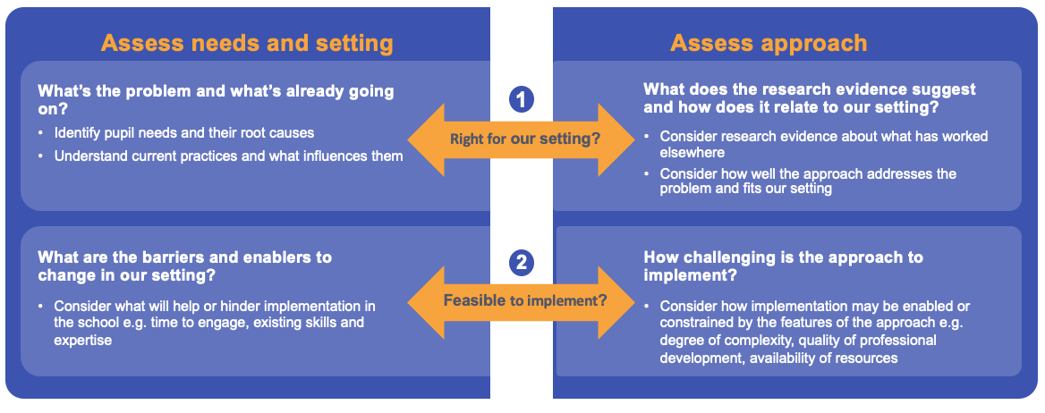
Sustain
“The seeds for sustainability are sown throughout an implementation process. This means adopting the right implementation strategies and ensuring they include the behaviours and contextual factors.”
Maintain the effort
Revisit implementation plans, refresh PD, sustain support from leadership, make outcomes visible.
Review and act
Sustain?
Scale?
De-implement?
Notes:
SUSTAIN:
Finally, 'Sustain' is divided into:
'Maintain the effort':
We remind schools that the seeds of sustainability are sown throughout the implementation process – this means ensuring that when we use implementation strategies, they include the behaviours and contextual factors
We recommend revisiting implementation plans, refreshing PD and ensuing that improved outcomes are made visible to staff.
'Review and act'
This offers a more structured decision-making process than in the previous guidance. We walk schools through how to conduct a through review of implementation (for example, by reassessing pupil needs and implementation readiness) and outline some 'next steps': sustaining the approach by embedding it in the schools' systems and structures; scaling up (or down!) the approach, which will require a reassessment of new potential barriers; or de-implementing the approach altogether – for example, if we feel it has served its purpose.
Those are the four phases. As we have talked through it, you'll have noticed that we refer back to the Behaviours and Contextual factors throughout (show next slide)
Two headings
Mantaiing the effort
PD signs of cusccess
Responsive
Eyes on the stone monitoinrg and improving it
Review and act
Fluidity
Revist implantation plan – is it fit for purpose – are needs the same - are we still alignrd with the evidence- review – make decisions
To sustain, scale or de-implement
Sustain
More to say on this
Previous versio was a page
Evidence been useful on what gains sustainability
Big list
Range fo factors that build sustainability
Those factors underpin that section
List
How many engage with behavious

Slide 47
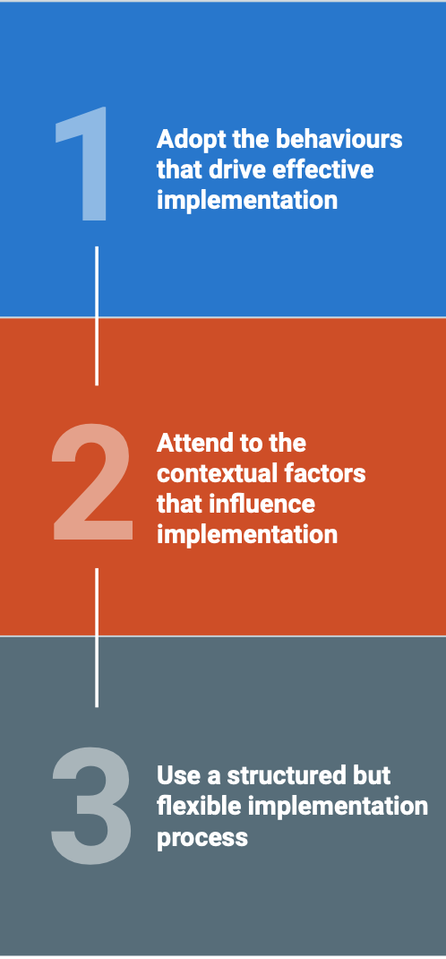
Notes:
(Following on from the previous slide)
...That's because these three elements are intended to be used together. The process helps schools do implementation. The cross-cutting behaviours and contextual factors helps them do it well.
On the left, you can see the three headline recommendations.

Slide 48
Reflections and Action Planning

Slide 49
To summarise…

Slide 50
Plot and subplots
Main plot:
Current guidance report focuses on how to do implementation - the update pinpoints how to do implementation well. It’s a conversation around quality.
Sub-plots:
Implementation in schools is complex and dynamic - a process of ongoing enquiry
Social nature of implementation, yet supported by systems and structures
Evidence-informed implementation: implementation includes evidence-informed decision making (on what is implemented and how)

Slide 51
@JTStaffsRsch @ArkinstallNikki
What is your main takeaway from the session?
What are you going to do as a result of this session?
Who are you going to share this with?
Notes:
We are here to support you and your organisation

Slide 52
https://shorturl.at/egxA7
Notes:
We are thrilled to be able to announce the upcoming release of the EEF's latest Implementation Guidance report, set to debut in just two weeks! This comprehensive resource promises to be a game-changer for school leaders, offering insights drawn from extensive research. Packed with actionable recommendations, this guide equips leaders with the knowledge and support they need to spearhead transformative changes and drive improvements effectively. We would love to invite you to one of our launch events so that you can find out all about this fantastic new resource.

Slide 53
https://shorturl.at/ety35
https://shorturl.at/gpvCQ
Notes:
Please share with any colleagues who you think may find these sessions useful.

Slide 54
Further Opportunities

Slide 55
https://researchschool.org.uk/staffordshire/event/leadership-weekly-email-series
Notes:
https://researchschool.org.uk/staffordshire/event/leadership-weekly-email-series

Slide 56
Notes:
Nikki
Deliver promising approaches in your setting at a heavily subsidised rate.
We fund most of the costs of the programmes we test, so settings in the intervention group are getting access to promising programmes for free, or at a highly subsidised cost. For some projects, we might ask schools to contribute a small amount towards the programme they are receiving. If your school is in the control group, you are likely to get a thank you payment for taking part in the evaluation.
Access professional development for your staff.
Most of our projects involve high-quality professional development and support resources, so taking being part of the intervention group means you will receive this and support your staff and setting’s ongoing improvement.
Contribute to the evidence base and support your colleagues to improve teaching and learning.
Over half of all schools in England have taken part in an EEF trial. Every one of them has made a valuable and long-term contribution to the education evidence base by supporting the profession to improve teaching and learning through better use of evidence.

Slide 57
Notes:
Nikki
Deliver promising approaches in your setting at a heavily subsidised rate.
We fund most of the costs of the programmes we test, so settings in the intervention group are getting access to promising programmes for free, or at a highly subsidised cost. For some projects, we might ask schools to contribute a small amount towards the programme they are receiving. If your school is in the control group, you are likely to get a thank you payment for taking part in the evaluation.
Access professional development for your staff.
Most of our projects involve high-quality professional development and support resources, so taking being part of the intervention group means you will receive this and support your staff and setting’s ongoing improvement.
Contribute to the evidence base and support your colleagues to improve teaching and learning.
Over half of all schools in England have taken part in an EEF trial. Every one of them has made a valuable and long-term contribution to the education evidence base by supporting the profession to improve teaching and learning through better use of evidence.

Slide 58
Notes:
Nikki
Deliver promising approaches in your setting at a heavily subsidised rate.
We fund most of the costs of the programmes we test, so settings in the intervention group are getting access to promising programmes for free, or at a highly subsidised cost. For some projects, we might ask schools to contribute a small amount towards the programme they are receiving. If your school is in the control group, you are likely to get a thank you payment for taking part in the evaluation.
Access professional development for your staff.
Most of our projects involve high-quality professional development and support resources, so taking being part of the intervention group means you will receive this and support your staff and setting’s ongoing improvement.
Contribute to the evidence base and support your colleagues to improve teaching and learning.
Over half of all schools in England have taken part in an EEF trial. Every one of them has made a valuable and long-term contribution to the education evidence base by supporting the profession to improve teaching and learning through better use of evidence.

Slide 59
https://educationendowmentfoundation.org.uk/projects-and-evaluation/projects-recruiting

Slide 60
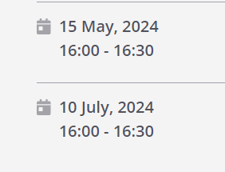
https://researchschool.org.uk/staffordshire/event/improving-the-effectiveness-of-your-cpd-programme
https://rb.gy/bzmcqi
Notes:
https://researchschool.org.uk/staffordshire/event/improving-the-effectiveness-of-your-cpd-programme

Slide 62
Notes:
Thank you
Please complete the feedback form

