Slide 1
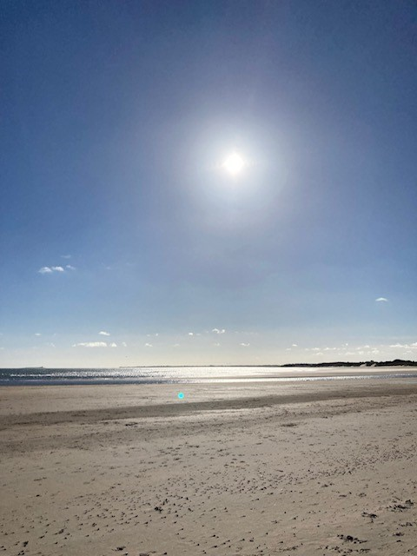
Embodying a sense of place and community in the curriculum
There is no power for change greater than a community discovering what it cares about.”
Margaret J. Wheatley
Julia Hancock
Boundless Learning Ltd
Rethinking Curriculum Chartered College
Notes:
Me… curriculum, English SLE, RSC, community, research EQ and academic achievement, metacognition which I wrote about in The Working Class…also about cultural and social assumptions now ….LSP…somatics, mindsets….all 4…whole child, whole world…deep learning, not fragmented, learning and life…hence boundless…
Work with schools from trainees to school development and resilience projects.
Vision…., resilient leaders elements… all layers can support children right up to leadership and organization.

Slide 2
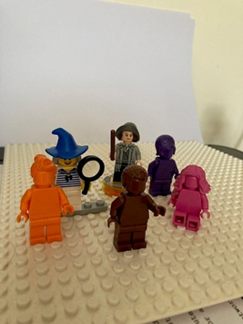
Who are you?
Individual identity: values, gender, roles, purpose, family, age, class, ethnicity, language, mental/physical ability/talents/likes & dislikes, place, accent
Group identity: shared values and purpose, beliefs, habits, pastimes, place
Organisational: Values, vision, mission, purpose, outcomes, place
Geographical: location, heritage, memories, significant places, activities, home
Social: Relationships, values, shared understanding, communication, hobbies, pastimes, place
Cultural: values, beliefs, place, class, status, sexual orientation, language, ethnicity
Notes:
If I asked you who you are and to introduce yourself, these are just some of the considerations you would make in terms of defining your sense of self.
You’d probably tell me where you live and possibly where you are from. You may even have a distinctive accent that may link you to a specific place. For example, I have a Midlands accent, but I’d be clear I’m actually from the North East and I lost my Geordie accent when I was 5…it matters to me. I am proud of my cultural heritage and working class roots. It shaped me.
I could share the various roles I’ve had, including my headships, Sle etc, or I could talk about purpose and the impact I have on the world…
Ultimately Our own sense of identity is wrapped up in the relationships we have with people and places. These shape our sense of self, our emotional intelligence and self concept-and our sense of worth.
Where we are is important to who we are… and ultimately what we achieve and do. We may be able to recognise this clearly as individuals, but how far we consider this as organisations, schools and teams is sometimes blurred by a host of other pre occupations…or priorities.

Slide 3
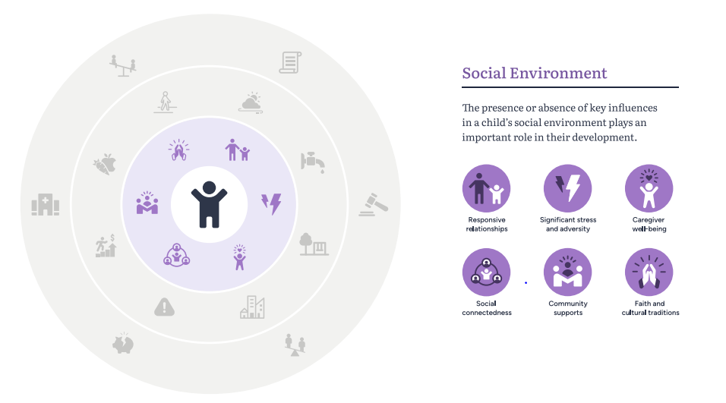
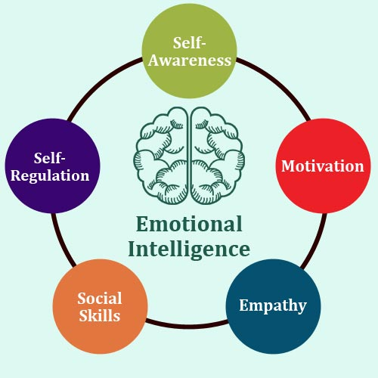
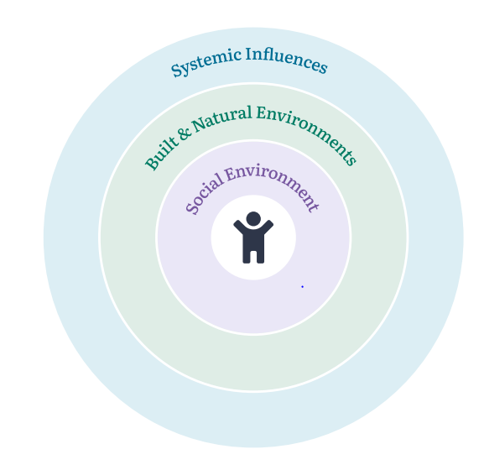
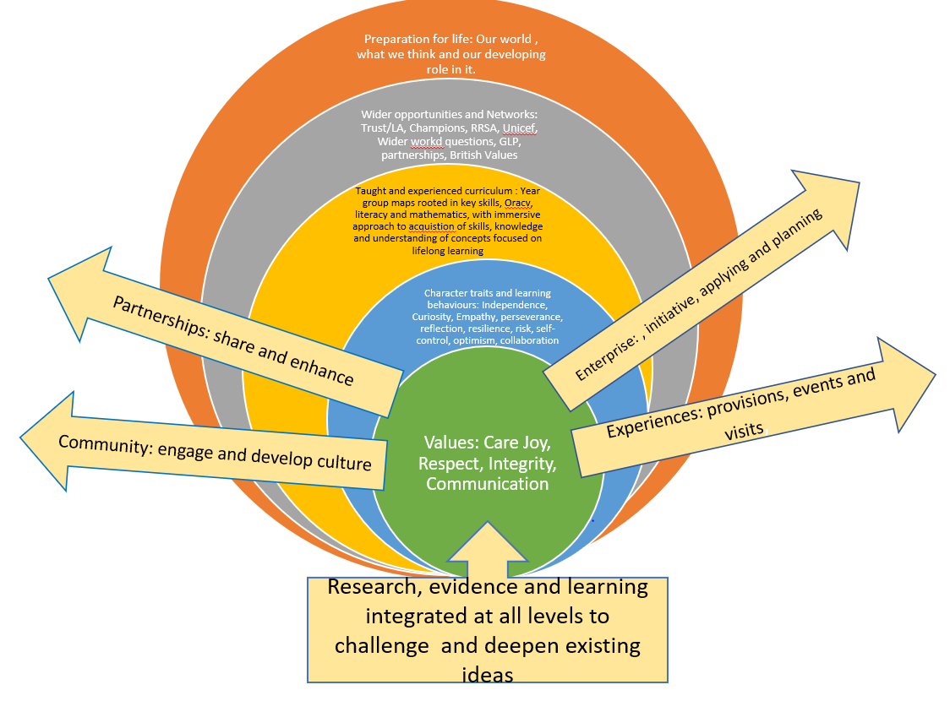
Sense of self and others
This Photo by Unknown Author is licensed under CC BY-NC
Notes:
Much of my work is informed by my research into EQ…MA exploration in developing children’s active engagement in learning and metacognition/afl… led to my work with the RSC across schools..involved community projects and National collaborations. For me, leading in a small white working class rural school it was important to value cultural experience, and open up the world , immediate and beyond…creative projects where the whole community from across 7 schools took part in a collaborative performance… all different rooms. Movement coach flew in from Chicago… Polly Bennet who went on to work with Austin Butler on the Elvis movie! That was a huge check in in terms of how globally small things can become, but also how we can reach beyond our known horizons too.
Key to all my work, with chn or adults is developing Emotional Intelligence, Values, interaction with world, sense of place in space and time…Key to developing social awareness , intrapersonal and interpersonal skills. My own curriculum development expertise was founded in this…EQ at the centre…taught and experienced curriculum with key strands running through and key guiding questions to apply across concepts and community enquiry… Threads running through…
Link to aims of curriculum. If we want to enable our children to thrive in the world, and have a clear vision for this, do we know how they see themselves? How secure is their sense of self, place and identity? Have we considered if they see our school as a place that matters to them, a place that values them and what assumptions do we make about them?
The same goes for all of our stakeholders…parents. Where are they in the midst of this ? Governors? Community members? Our staff? Key consideration in terms of current diverse society and mobility of people
Key considerations for educators are
What do we know and what don’t we know? What would and do they feel and say? Do we even know?

Slide 4
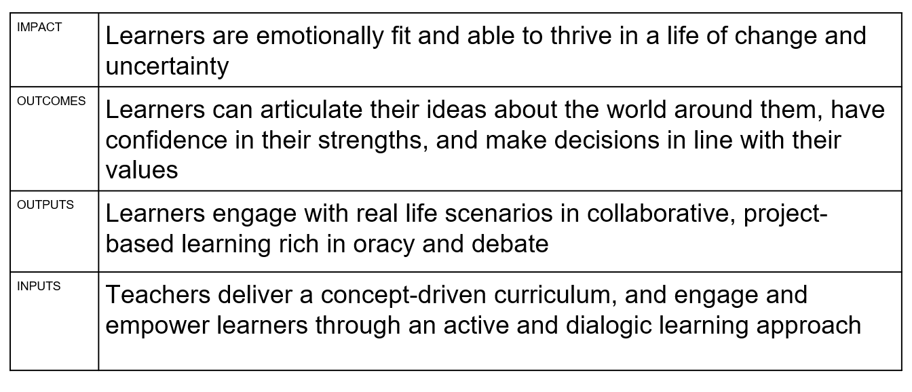
Curriculum design
Our curriculum is founded in deep questions nurture awareness of our place in the World, whilst valuing the traditions we all hold dear in our own local culture.
What do we know about our culture?
What does International mean?
What does it mean to be different?
How can we become independent by working with others?
What do we share with people from different times and places and what can they teach us? How do ideas travel through time?
Inspiring curiosity in the world, we greet challenge with optimism and seek the joy in life.
Notes:
My experience of curriculum development, informed by research with IOE, Leading On NPQH Curriculum evelopment, work with Gareth Mils from NFER, Specialist leadership, as well as Network leadership work.. Consideration of cohesion from vision, TOC…what this looks like, and ensuring coherence and meaningful, relevant, rich experiences. Important leaners see themselves in the world. Examples of my work…
What matters, who we are ,at the centre, before considering what we do…then what we need, want to be, and how that is organised….
Personal development and characteristics we want to embed, development needs and priorities
Taught and experienced curriculum…mapping Taught and experienced curriculum : Year group maps rooted in key skills, Oracy, literacy and mathematics, with immersive approach to acquistion of skills, knowledge and understanding of concepts focused on lifelong learning
Meaningful connections linked to intent, engagements and collaborations : Wider opportunities and Networks: Trust/LA, Champions, RRSA, Unicef, Wider world questions, GLP, partnerships, British Values
Ultimate consideration…How do we make this relevant?
Running threads to fuel and support…partnerships that share and enhance learning, community engagement and culture, Enterprise and agency, Wider experiences bringing learning to life…not fragmented experience ..
Purposeful, informed by learning, rooted in learning for the person they are and want to be, and for the world they live in…
Using International Primary curriculum aims, designed a set of questions to support coherence and review across all year groups…informed assemblies, producing for audience, and reflection… Also crucial to thriving and wellbeing.
If we consider this in terms of developing resilience learners, I’ve found the RLE model useful
In a school everyone contributes to our sense of self…. So
Everyone needs to share an understanding of who are we and what are we doing…

Slide 5
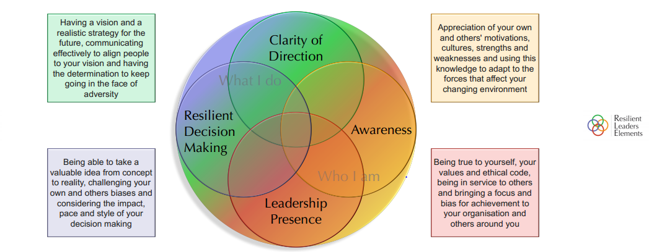
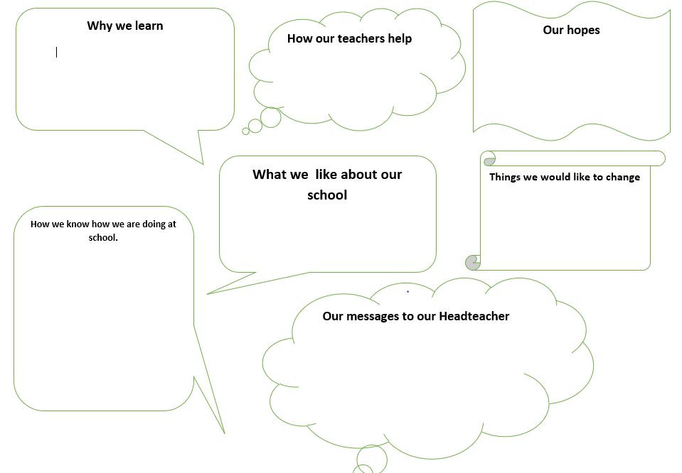
Our environment
Notes:
Also crucial to thriving and wellbeing.
RLE model
In a school everyone contributes to our sense of self…. So
Everyone needs to share an understanding of who are we and what are we doing…Clarity of direction…. What is it we want for our school community? What does that look like, feel like, sound like? Informs much of the coaching approaches and facilitation with staff…Integration of LSP to support this…build concrete visualisations to consider where stakeholders are and their perspectives…views.
I use this with teams… to reflect , organisational or individual to see where everyone fits in…also model and approaches with children…key questions to develop their own awareness and metacognitive processes… in the RC project, we used reflective journalling approaches…

Slide 6
Our environment
10 Big Hopes for Education
www.big –change.org
1 There is a public conversation about education
9 Schools and communities thrive as part of local learning ecosystems
Valerie Hannon, Global Education Leaders’ Partnership
As humans we need to be thriving on four levels:
Internally in terms of developing a real sense of self, accessing calmness and taking care of our bodies.
Interpersonally in terms of our relationships
Societally in terms of our communities
Planetarily or globally
Parents play a crucial role in supporting their children’s learning, and levels of parental engagement are consistently associated with better academic outcomes.
Evidence from the Education Endowment Foundation (EEF) Teaching and Learning Toolkit suggests that effective parental engagement can lead to learning gains of +3 months over the course of a year.
Notes:
In my work in schools we Open up perspectives and consider the wider world,. How do we fit in, what does this mean for our children and staff. Since Covid, this has been even more crucial-the world changed… many families endured prolonged trauma and grief, significant mental health issues, financial challenge and anxiety.
Also crucial to thriving and wellbeing. Wider consideration of environment…place and people.
Key areas of research have informed some of my own approaches…Valerie Hannon suggests if we start with the levels of thriving as our premise, we start to consider some different answers in relation to what we should be doing.
Parents are integral to this…link with current and past places…also community. They should be involved in the conversation
In school community Everyone needs to share an understanding of who are we and what are we doing…Clarity of direction….
In a school everyone contributes to our sense of self…. So everyone needs to be united in their ambitions…parents, communities and wider..
In exploration we can identify what next…

Slide 7
What matters?
Key idea : What is the unique flavour of our school and how do we see this?
Who understands it?
Who are we?
What do we do?
Curriculum purpose:
Intent and implementation
Notes:
Leicestershire..crisp packets…flavour…what’s in the packet? What are our children tasting and how does this represent who and where we are?
Whether I work with teams or individuals, or in leading curriculum projects, key aspect…belonging, identity.
Models in relation to functioning…Barrett values, Valerie Hannon, EEF working with parents
What do we stand for ? What are the outcomes we want to see for our community?
What is the current view? Whose view is obscured?
Formed the basis for staring to work together… what do we say we do? Who do we want to be?
Explore where they are…where do we want them and why? How do they contribute to our vision?
Recently, considering Parent mapping, how and what are we doing to engage, support and partner with our families? Are there any that feel excluded?
Curriculum review…local, National global…how does it serve our vision? Where are the opportunities? Who are the opportunities? Whose voices are heard?

Slide 8
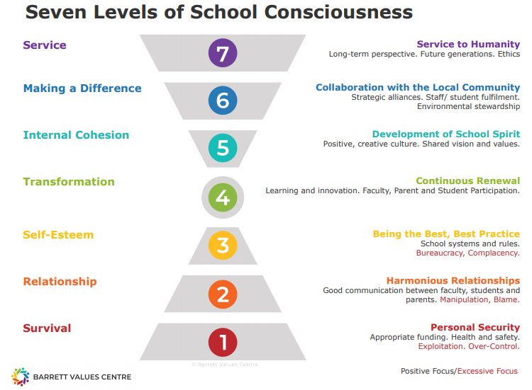
What are we seeing through our window?
Where are we?
Notes:
If we consider model in terms of considering our whole school shared values, and how these impact on the decisions we make, their impact on motivation and our vision for our children to be able to lead meaningful lives in society, then this model enables us to reflect on what we and our community can use to support our curriculum.
We begin to get a sense of what matters and who matters, and what may be currently working well, or what we need to tweak or start doing.
When I work with leaders, we examine strengths, areas less well developed and opportunities…can’t just stay safe at the bottom.

Slide 9
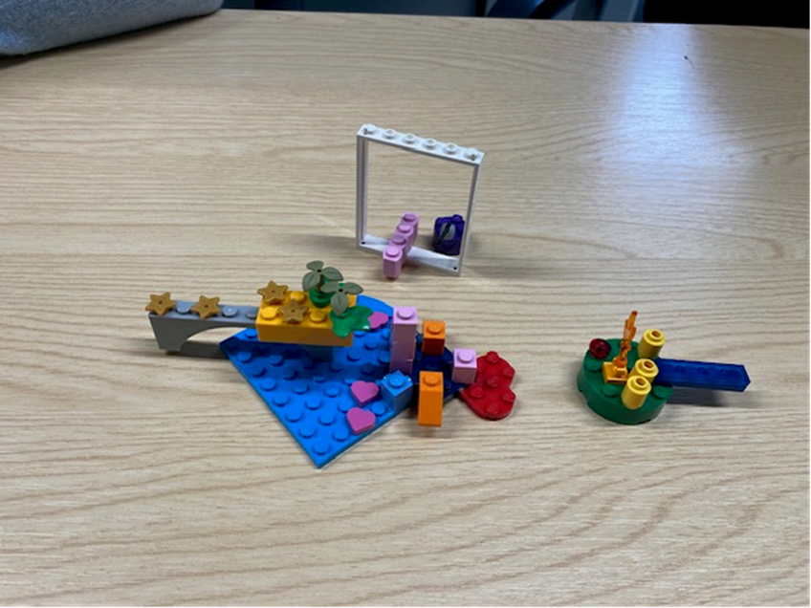
Who are we and who belongs?
Where are our stakeholders?
What is their view?
What are they doing? Seeing? Hearing? Feeling?
So whose voices do we need to enable?
Where are the gaps in our map?
Notes:
So we have to consider How does our curriculum develop the legacy, enable everyone to thrive?
Clear vision that everyone owns and shares…how will you do this?
What needs to be celebrates? What really matters and what do we need to tweak/change/start and stop doing?
Hearing the voices….who is active/ passive? Where are the gaps in our map? Explorers… Using LSP, this gives me the chance to explore this with teams and schools, offering concrete models to explore, offer new perspectives. Memorable …interaction with each other and stimulates reflective analysis, as well as creative solutions.

Slide 10
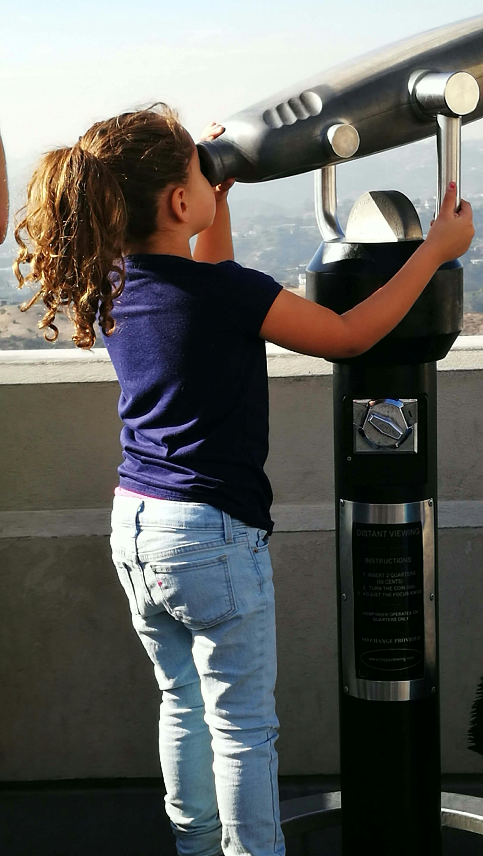
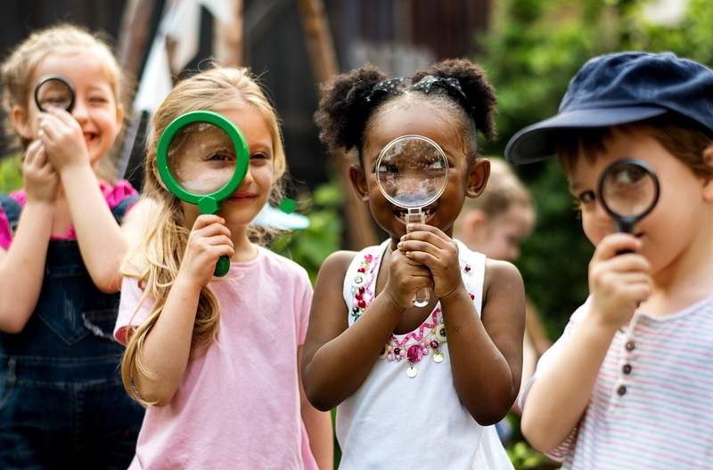
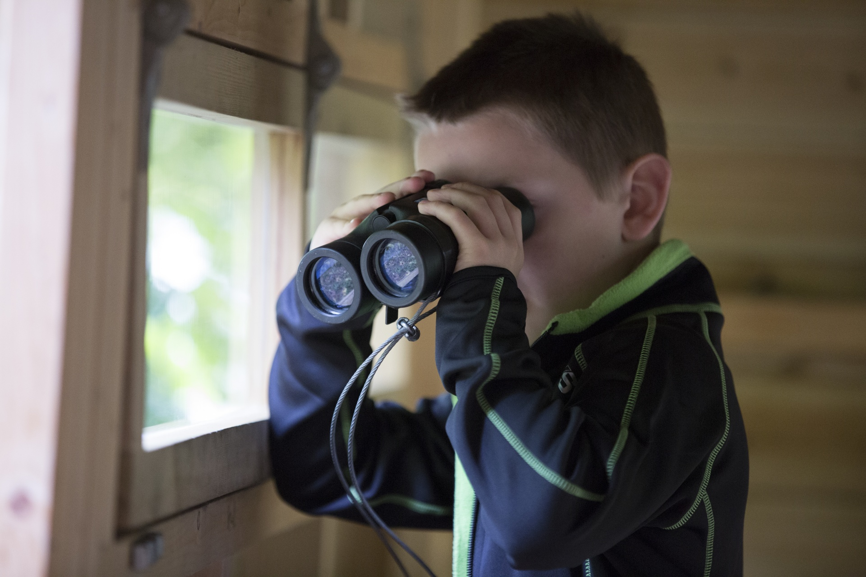
Who and where matters?
How does the curriculum reflect who, where and what matters?
What does our school voice say and where from?
How do we know whose voices are heard?
Where are the others and who can’t we see or hear?
Notes:
From this we can determine what we need to further consider,
Rethinking Curriculum, we started with the children-their voices, mapping parental engagement- where are we engaging with them, supporting them and partnering with them. This helps consider a plan, as well as discover hidden beliefs, cultural and community connections.
We’ve started to think about the experiences children have and how to maximise their sense of place, and appreciation of their own rich cultures, The school is looking at curriculum planning and considering community members that can enrich the experiences, not just in a class visit, but in expanding this on a concepts and wider world understanding, eg Guide dogs, building from what we know and expanding the view…
Also examining assumptions and views…considering the diverse range of views in the community…and offering the school space for connection.
Pupil leaders…currently as a Chair of govs and in resilience programmes with children, developing leadership, seeking their view
Pupil leaders, pupil reflections, where are they leading?
What can they see and what opportunities can they see?
Pupil leadership teams… pupil SEF, start with reflections, and build….

Slide 11
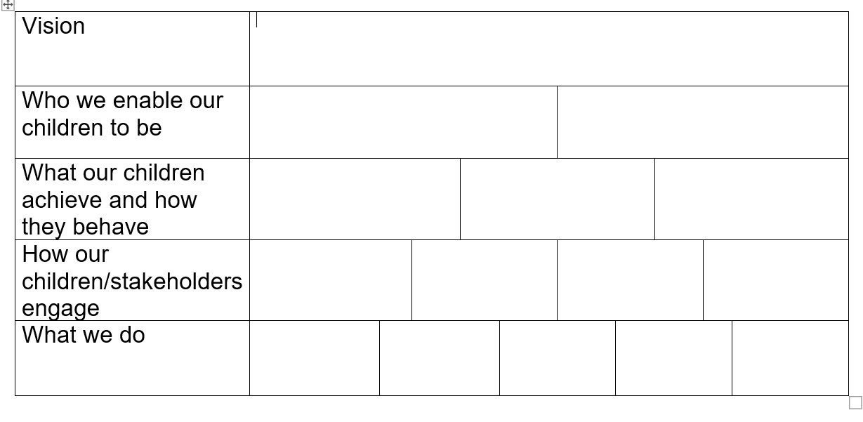
What matters to us? Why?
Notes:
Use this model to support theory of change…Boundless inspiration, embodying the vision…support SIP.
So then…considering
How does our curriculum develop the legacy, enable everyone to thrive?
Clear vision that everyone owns and shares…how will you do this?
What needs to be celebrates? What really matters and what do we need to tweak/change/start and stop doing?
This then steers the adjustments, then continuous reflection and what the place where children learn means in terms of their development…true impact, embodying the place we say we are and want to be.

Slide 12
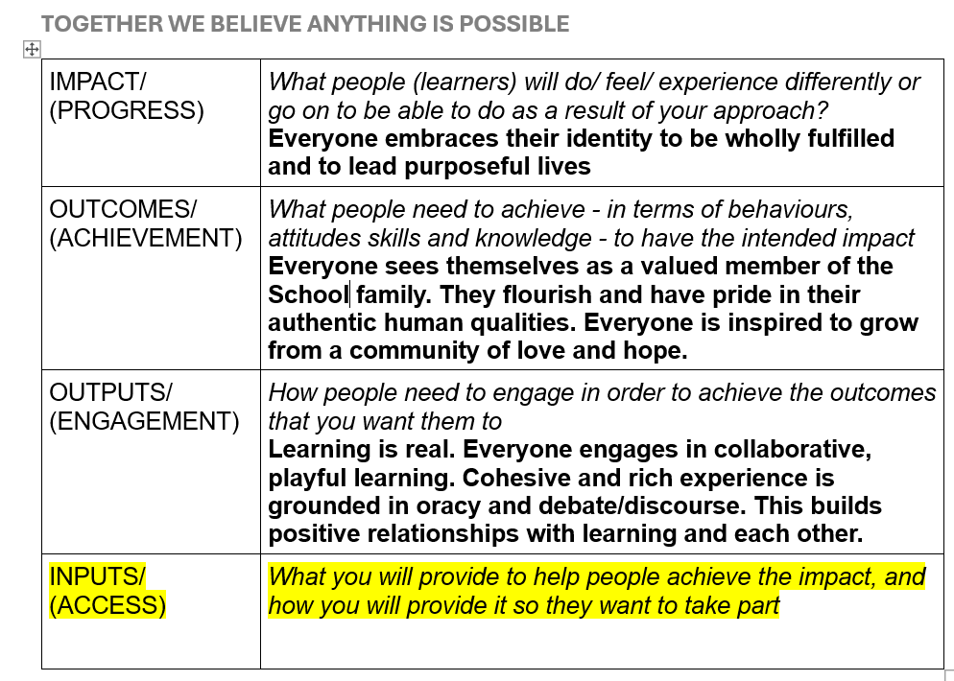
Who, what and when?
Notes:
What key actions can we take and when-who is best placed to take the lead? Then we can consider what it is we need to measure and celebrate, we take ownership of what matters in our community.
May be people in wider community…. School really is community…and place that enables everyone to believe anything is possible.
The opportunities are truly boundless and beyond any metrics we may traditionally be bound by…we can consider the metrics we want to measure and celebrate.
What will we celebrate? How will we celebrate and with whom?

Slide 13
Over to you
What matters?
Who matters?
Who is missing?
Whose voice steers your course?
Who is lost at sea?
How can you make sure everyone knows the way?

