Slide 1
Developing student agency & pupil voice
Emmanuel Awoyelu

Slide 2
Student agency:
What: Giving children the responsibility, ownership and choice regarding their learning and ways of learning.
Why:
To acknowledge in life there is a process - A process of learning
To promote independence
To allow mistakes to happen - developing a growth mindset
To develop metacognition

Slide 3
HOW?
Within lesson plans, consider something children can DISCOVER i.e problem solving scenarios
Provide children with more than one way of arriving at the final outcome i.e multiple methods of solving a math problem
Inclusion: Identify the learning objective. How can children meet that learning objective.
Example
LO: Describe a type of government
Outcome:
Orally present the government you’ve researched
Create a pre-recorded video
Write a blog on your chosen government

Slide 4
Pupil voice:
What: Giving children the opportunity to express themselves whilst developing their physical and metaphorical voice
Why:
We want to empower children with the skills needed to survive in this world
We want children to confident to express themselves
We want children to be confident speakers
We want children to be led by their moral compass

Slide 5
How?
Debates
Talkpartner opportunities
Podcasts for student council
Class discussions - circle time
Speak to the children, as humans
P4C - Philosophy 4 children
Talk4writing

Slide 6
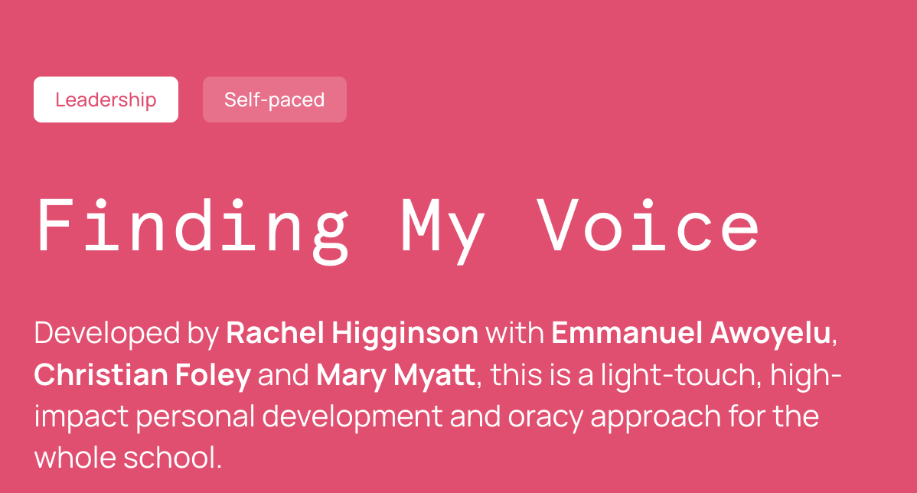

Slide 8
Developed through…
Culture
Personal Development curriculum
Authentic Oracy
Powerful Curriculum
Relevant and responsive content

Slide 9
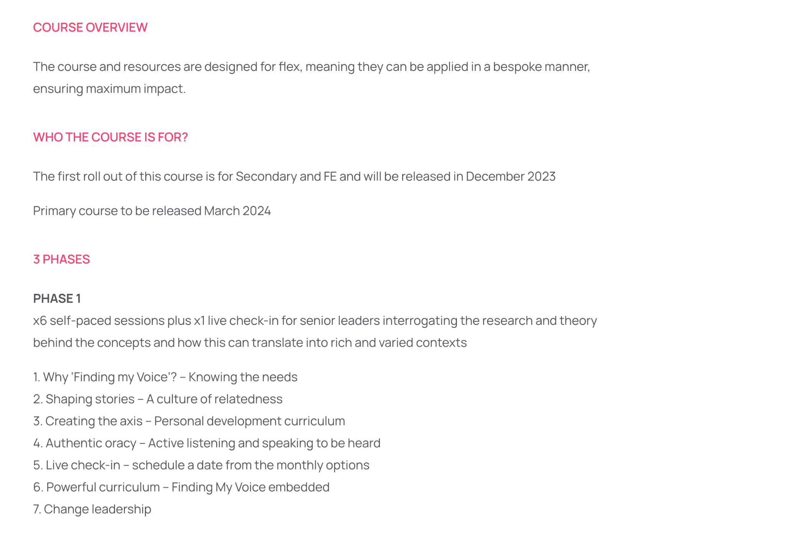
Link for booking : https://huhacademy.com/courses/fmv-2023/

Slide 11
Contact:
manny@mannyawo.com
Twitter: @Mannyawo

