Slide 1
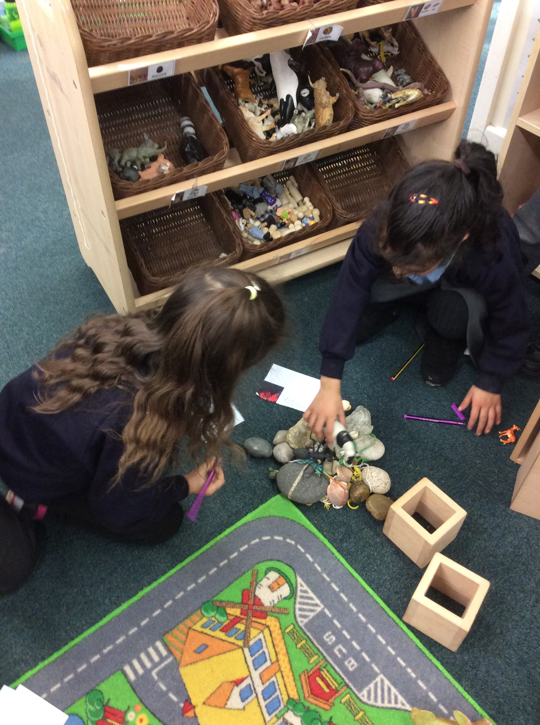
But...are they learning?
Taking Play Beyond the Early Years
@educatingellen
ellenparkereducation@gmail.com

Slide 2
In the next 10 minutes...
The ‘why’
Implementing play beyond the Early Years
Benefits, challenges and implications
Rationale behind our decision to adopt a play-based approach
What this looks like in practice
The reality of play-based learning and next steps
@educatingellen

Slide 3
The ‘why’
@educatingellen

Slide 4
"Play is the foundation of learning, creativity, self-expression, and constructive problem-solving. It’s how children wrestle with life to make it meaningful. ” - Susan Linn
Began with the realisation that we were not maximising full potential in Year 1
Drew on research (Alistair Bryce-Clegg, EEF, Julia Fisher) and collaborated with Greg Bottrill
Limited evidence of developmental characteristics between ages 5-7, often comes before and after this. Therefore, nothing to suggest that pedagogy in EYFS is inappropriate up to age 7 (Fisher, 2020)
Wanted to build on the core principles of EYFS:
Every child is unique
Positive relationships
Children learn and develop well in enabling environments
Children develop and learn at different rates
Susan Linn, writer and psychologist
Notes:
When looking at transition and continuity from Reception, we observed previous cohorts struggle with the demands of a formal Year 1, such as increased curriculum expectations and prolonged periods at desks, resulting in a passive approach to their learning and reduced learning time due to its discrete nature. To maximise outcomes for our Year 1 learners, we understood that our approach needed to evolve by building upon the principles and practice of the Early Years.
found through research interesting information such as - play provides opportunities for executive function development (Eberhart et al., 2023). Executive functions, for example cognitive flexibility and self-regulation, are considered more reliable indicators of academic success than areas such as early literacy (McClelland et al., 2014).
However, it should be recognised that the benefits of play-based learning extend beyond our most vulnerable learners. Developmental characteristics are not unique to specific year groups; children enter our classrooms with diverse starting points and their own early experiences. Play understands this and allows for a more inclusive and developmentally sensitive (Fisher, 2020) approach to education, recognising and responding to the individual needs and strengths of each child, regardless of background or circumstance.
so, with this in mind, we wanted to build on the core principles of the early years, particularly taking note of the last one…when children transition into year 1 from eyfs – they are only 6 weeks older, and often that break, espc in schools like mine, is quite significant for the children

Slide 5
The ‘why’
Grounding our rationale in research
Vision for Our Learners​
Vision for Us
Notes:
Research
As mentioned previously, grounded what we did with research to support and shape our rationale. our rationale started with us realising we could better meet the needs of our children, but understanding the why and the how:
Play is crucial for all learners, especially the most vulnerable (Allee-Herdon et al., 2019)
Executive functions (such as cognitive flexibility and self-regulation) developed through play are key early indicators of academic success, more than early literacy skills (Eberhart et al., 2023; McClelland et al., 2014)
Play-based learning acknowledges and responds to diverse starting points and early experiences of children (Fisher, 2020)
Play is not merely a 'prop' but a powerful tool for engagement and learning for all children (Howe, 2016)
EEF​
from here we created our vision

Slide 6
The ‘why’
Grounding our rationale in research
Vision for Our Learners​
Vision for Us
Notes:
Vision for our learners
All our children to become confident, inquisitive, and articulate learners
Plentiful opportunity to talk and collaborate with their peers
Intrinsically motivated and drive their own learning
Regular access to the wider curriculum
Increased opportunities to contextualise learning
Bring childhood back into the classroom

Slide 7
The ‘why’
Grounding our rationale in research
Vision for Our Learners​
Vision for Us
Notes:
Vision for Us
Moving beyond instructional learning and static knowledge​
Develop an inclusive and developmentally sensitive educational environment
Empower teachers

Slide 8
What this looks like in practice
@educatingellen

Slide 9
"If you overthink children's provision, you take away a world of endless possibilities.” - Alistair Bryce-Clegg
Alistair Bryce-Clegg, educational consultant

Slide 10
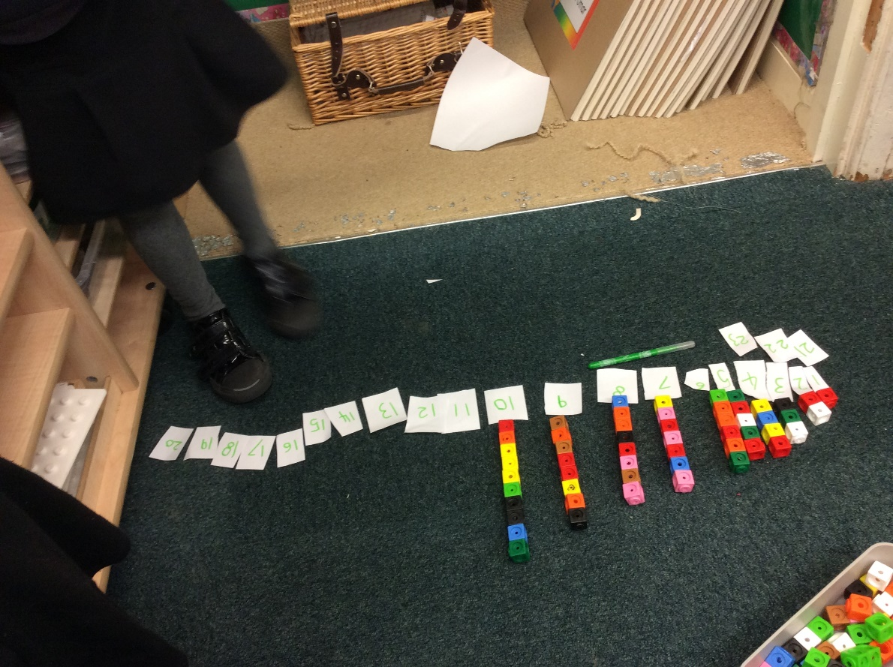
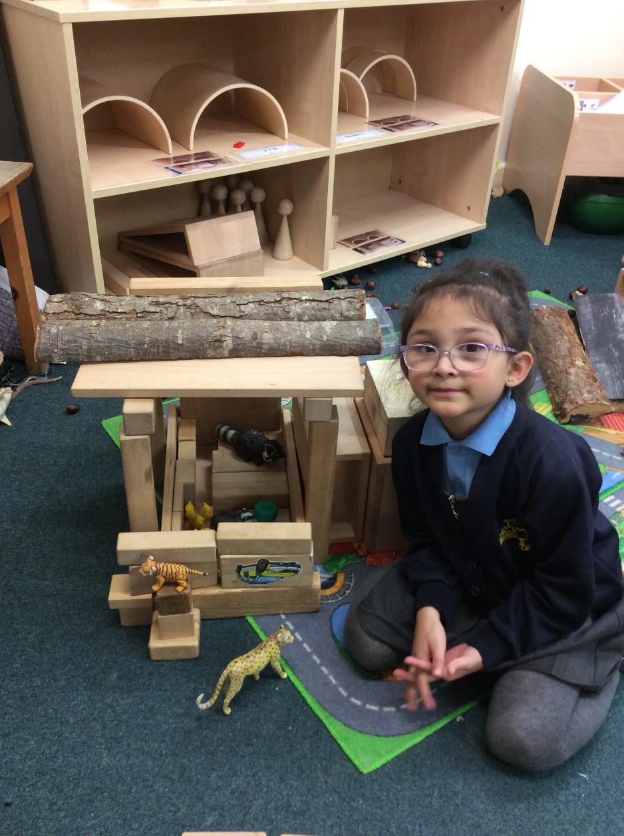
Play in practice
Environment – using the classroom as a second teacher
Enhancements – linked to your curriculum
Expectations – of both the adults and the children
Engagement – how the children are engaging with the environment and each other
@educatingellen
Notes:
these are our fundamentals in our thinking:
Environment – using the classroom as a second teacher
Enhancements – linked to your curriculum – what resources are part of the provision
Expectations – of both the adults and the children e.g. adult role/how children use and look after the environment
Engagement – how the children are engaging with the environment and each other – how they play and talk

Slide 11
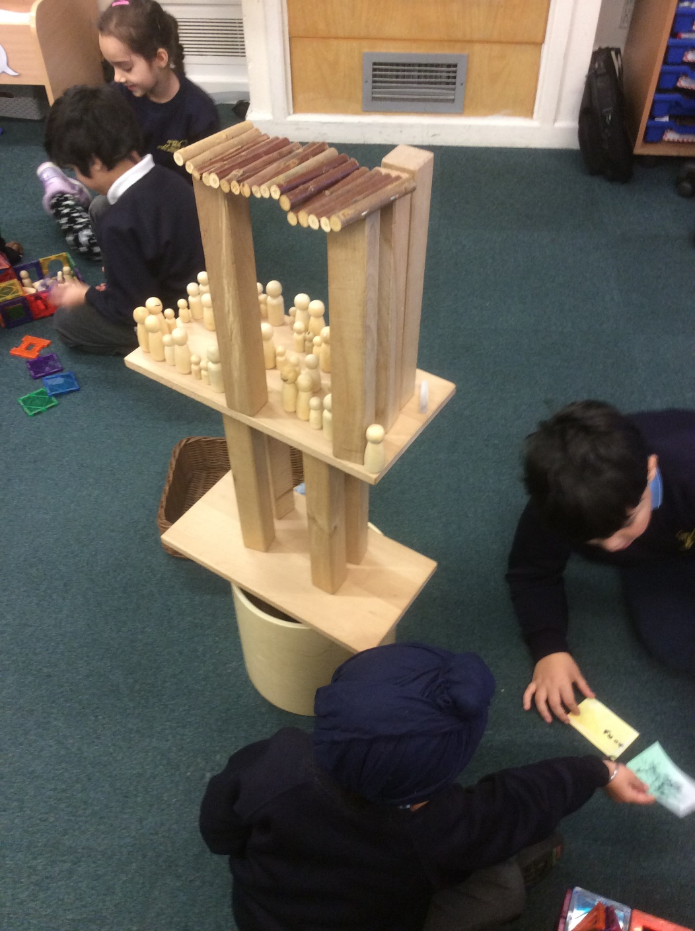
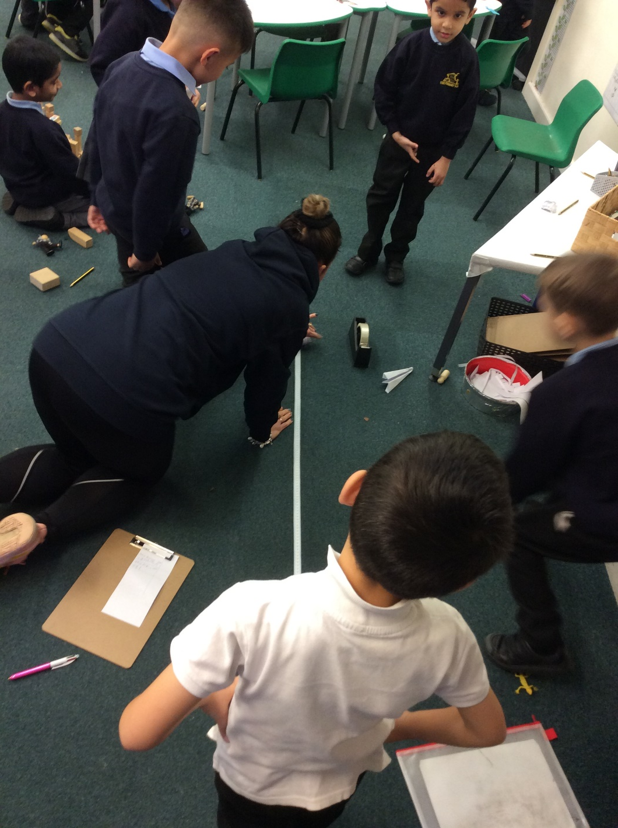
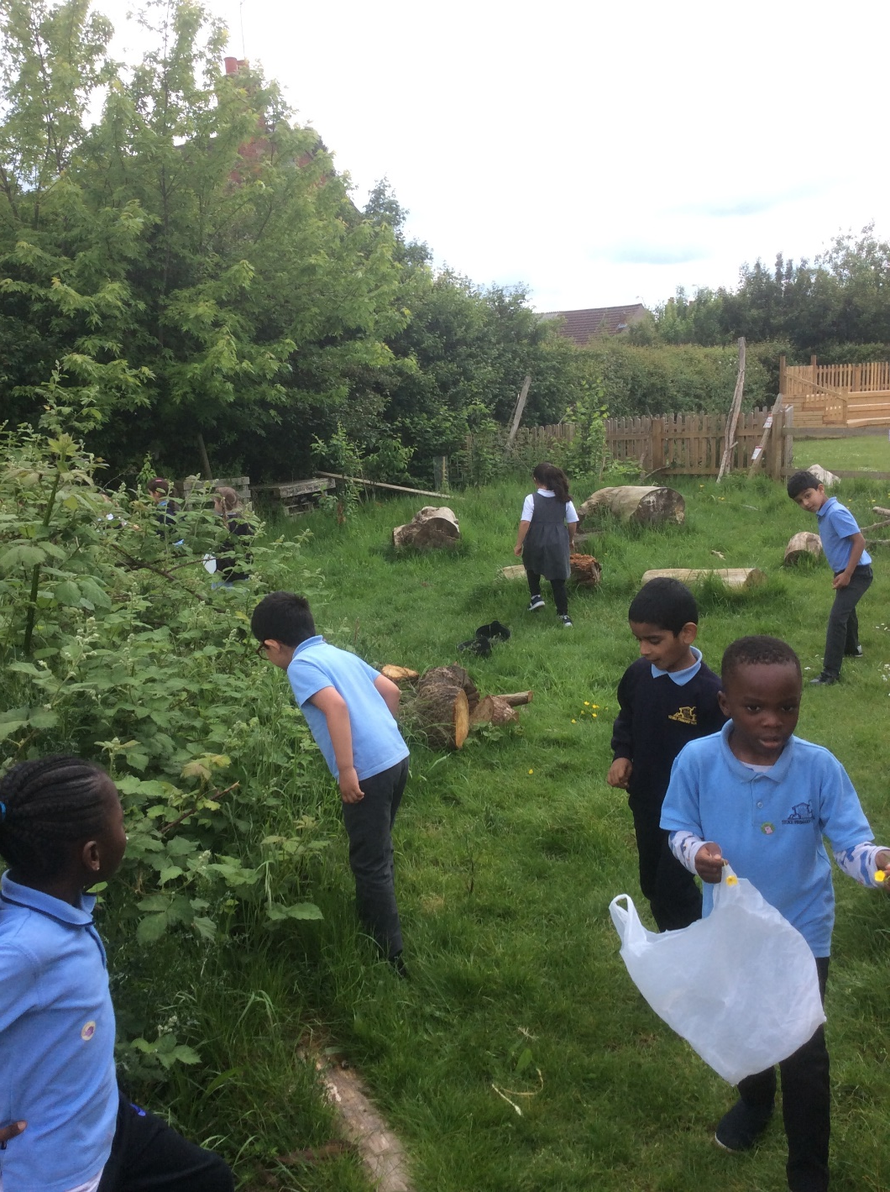
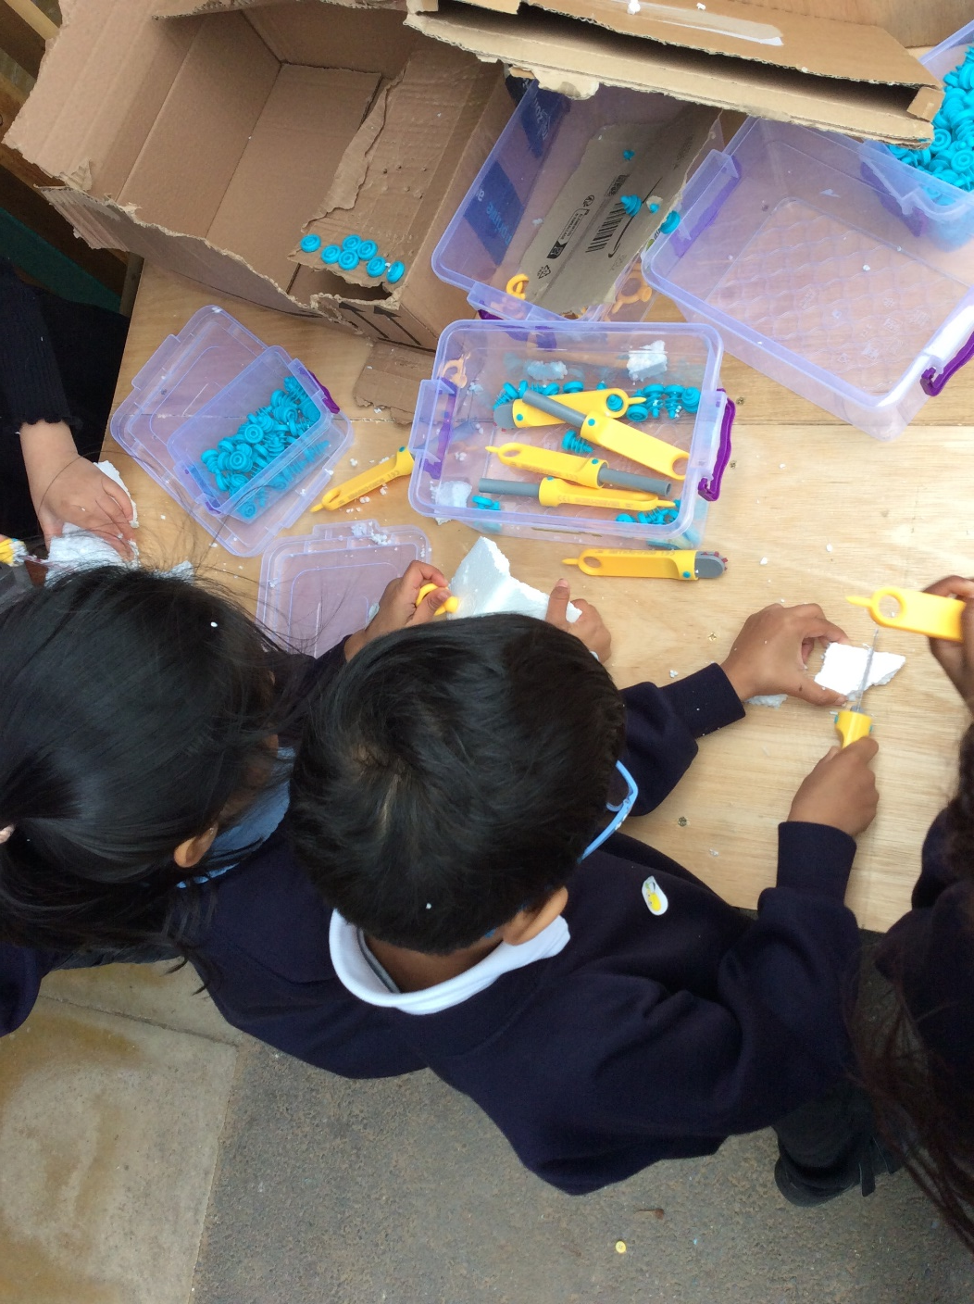
Play in practice
@educatingellen
Notes:
these are our fundamentals in our thinking:
Environment – using the classroom as a second teacher
Enhancements – linked to your curriculum – what resources are part of the provision
Expectations – of both the adults and the children e.g. adult role/how children use and look after the environment
Engagement – how the children are engaging with the environment and each other – how they play and talk

Slide 12
Play in practice
Year 1
Year 2
Open ended opportunities – don’t over setup
Evidence collated in a variety of different ways (not just value written outputs)
Play Project (Greg Bottrill)
Construction/small world/writing prompts/topic areas/craft/junk modelling
Parental engagement
Learning journals
Drawing Club -> Curious Quests (Greg Bottrill)
Dedicated outside area
Curriculum journals / independent journals / maths and writing book
Increased independence and ownership over learning e.g. structured ‘must do’s’
Access to wider school environment
@educatingellen

Slide 13
Play in practice
High quality play does not happen by accident (and it is easy for play to become low level)
Play is not a magic wand - important to differentiate between what it can teach and what it can consolidate (Fisher, 2010)
Evidence can be collated in a variety of different ways (not just value written outputs)
Timetables can be changed
Bust curriculum myths
@educatingellen
Notes:
things to remember
‘Bust curriculum myths’ e.g. I have to do writing everyday – do you? genres (Y1) – do you?

Slide 14
Implications
@educatingellen

Slide 15
Benefits
We have found:
A significant increase in time spent applying new skills
Continuous support and challenge tailored to each child’s individual starting point
A notable rise in learning talk amongst the cohort
Enhanced insights into each child as a learner and the skills they can use
Application of skills and knowledge across various contexts
Children WANT to write***
Notes:
children are supported and stretched from their starting point
the key focus for us has been to teach key skills/knowledge, that the children then apply and practice in the provision
continual development of gross and fine motor / self regulation - all of this needs to be ongoing so that children are in a place to acquire learning and apply it
play is not a magic wand – but it is about teaching them what they need while they also regularly access the wider curriculum and APPLY!!
***this was really key for us – production line writing vs purposeful writing – chn now see it as a way to enhance their play / share their learning

Slide 16
‘Challenges’
Progression
Aligning continuous provision with the National Curriculum
CPD for staff is a must
Assessment
But…are they learning? – wider school staff/leaders need to be willing to look for the learning and engage with continuous provision
Notes:
‘ where’s the progression’ – the increased demands of the curriculum provide progression. also see progression through naturally what the children are doing / how they are using the environment / + tweaks you make e.g. different shapes in construction in year 2
fitting it all in. there are somethings that are just teacher directed but that doesn’t have to mean formal
CPD for confidence and developing a shared vision
I would argue you are more confident in this

Slide 17
So, what next?
@educatingellen

Slide 18
So, what next?
Develop a deep understanding and belief in the effectiveness of play
Commit to ongoing reflection and refinement
Be willing to shift your mindset
Practically…
Go for it – embrace the journey!
Connect
Take time to assess your current learning environment and craft a clear vision
@educatingellen
Notes:
embrace the journey!
connect - with schools in your locality or beyond that have already implemented play-based learning models beyond the Early Years

Slide 19
We are on the cusp of change! #ProjectPlay
@educatingellen
ellenparkereducation@gmail.com

