Slide 2
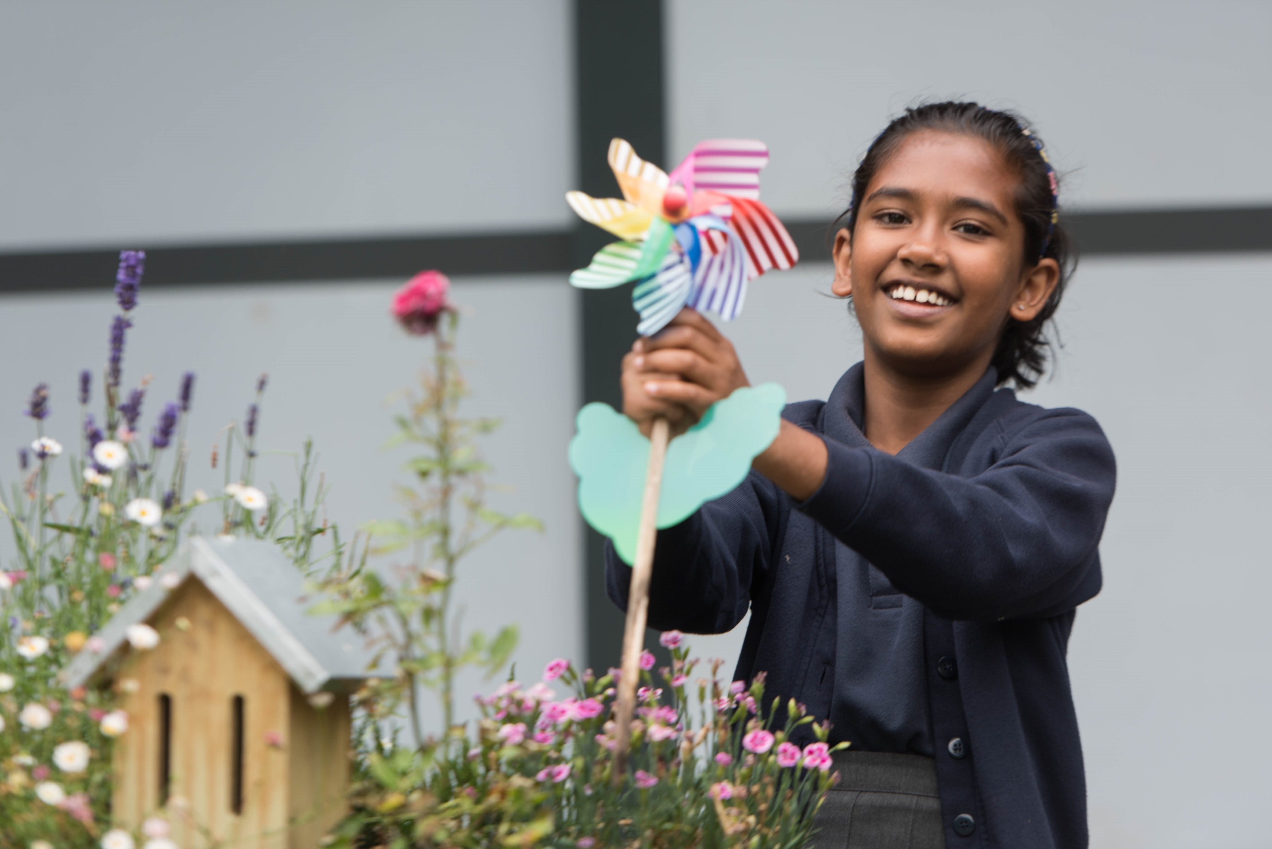
A journey towards environmental sustainability, where community can thrive, aspire and succeed.
Jenn Plews OBE: Trust Leader/ CEO

Slide 3

Our shared VISION
To nurture learning in a sustainable environment so that our whole community can thrive, aspire and succeed.

Slide 4

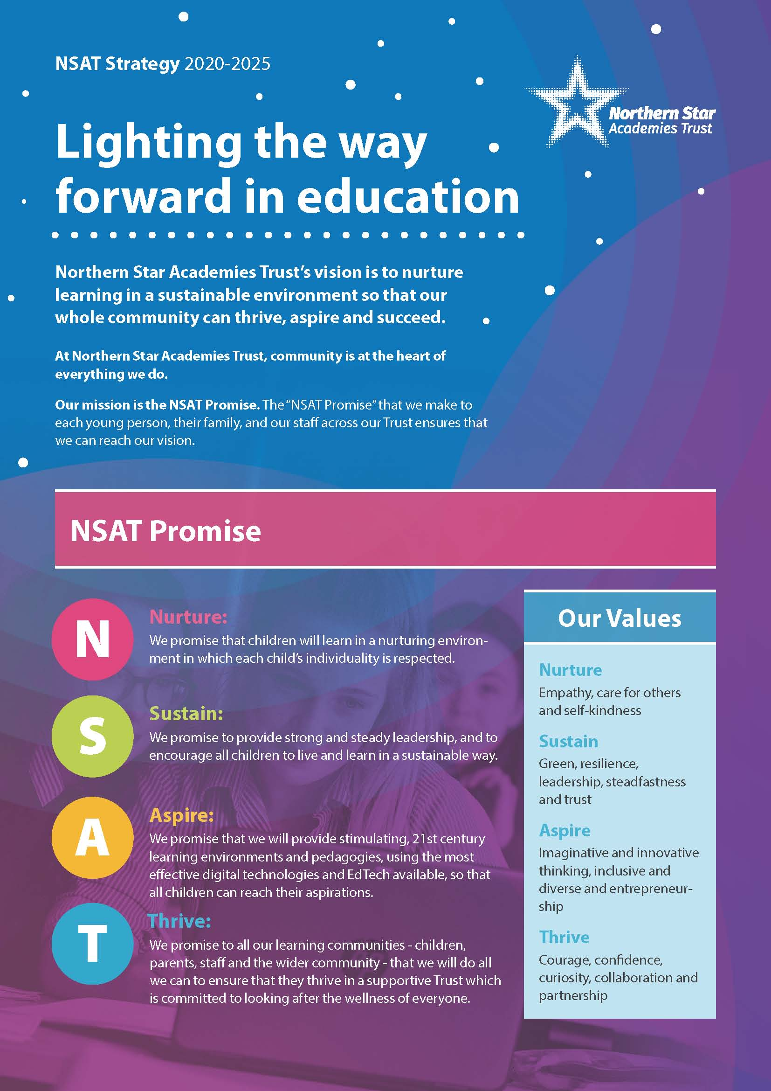
Our Whole Trust STRATEGY
Clarity of purpose, vision and innovation comes from our trust value: Sustain and our trust strategic priority. Environmental
Sustainability.
We are committed to meaningful change, finding new insights, solutions, and practices to deliver
green, relevant, and sustainable education.

Slide 5
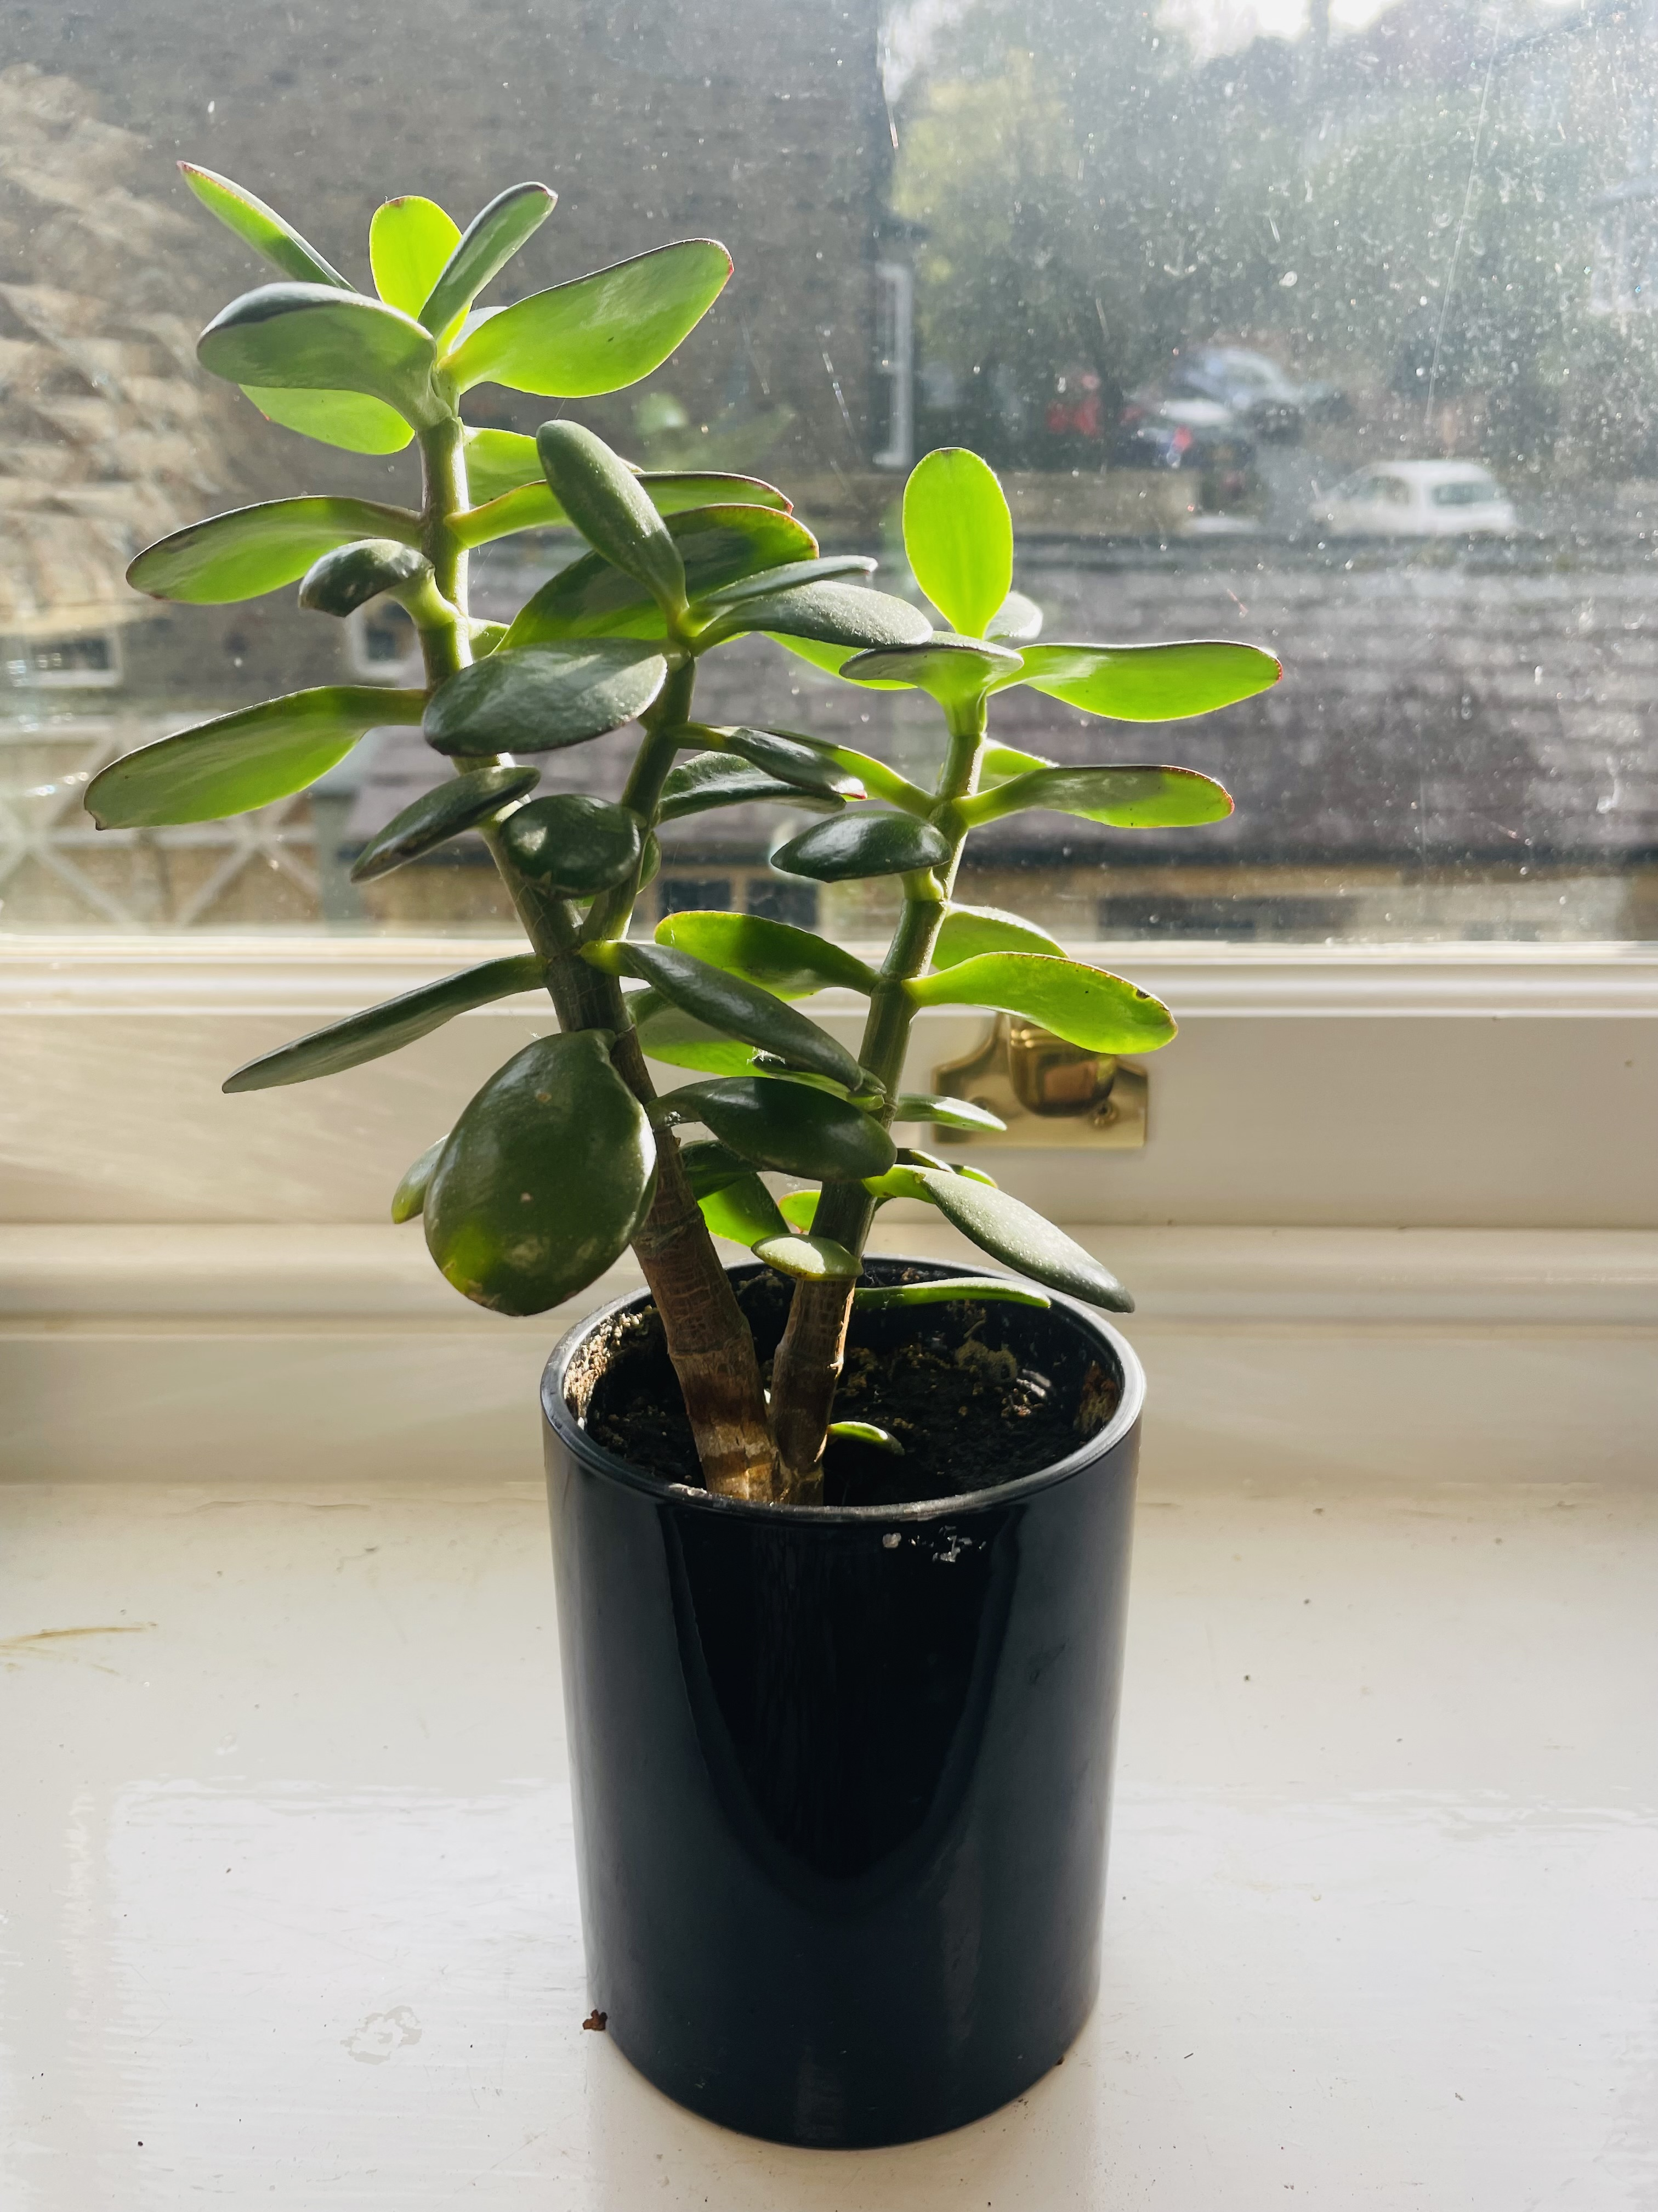
Our CULTURE Code
Belonging
Authentic
Safe
Trust
“Trust is what actually enables society to keep moving forward; trust is what enables innovation to happen. Trust is the conduit that enables new ideas to travel.”
Rachel Botsman

Slide 6


Reflective questions:
Why is a strong culture for collective climate literacy a priority?
What steps could you take to build collective climate literacy across your trust partnership?

Slide 7
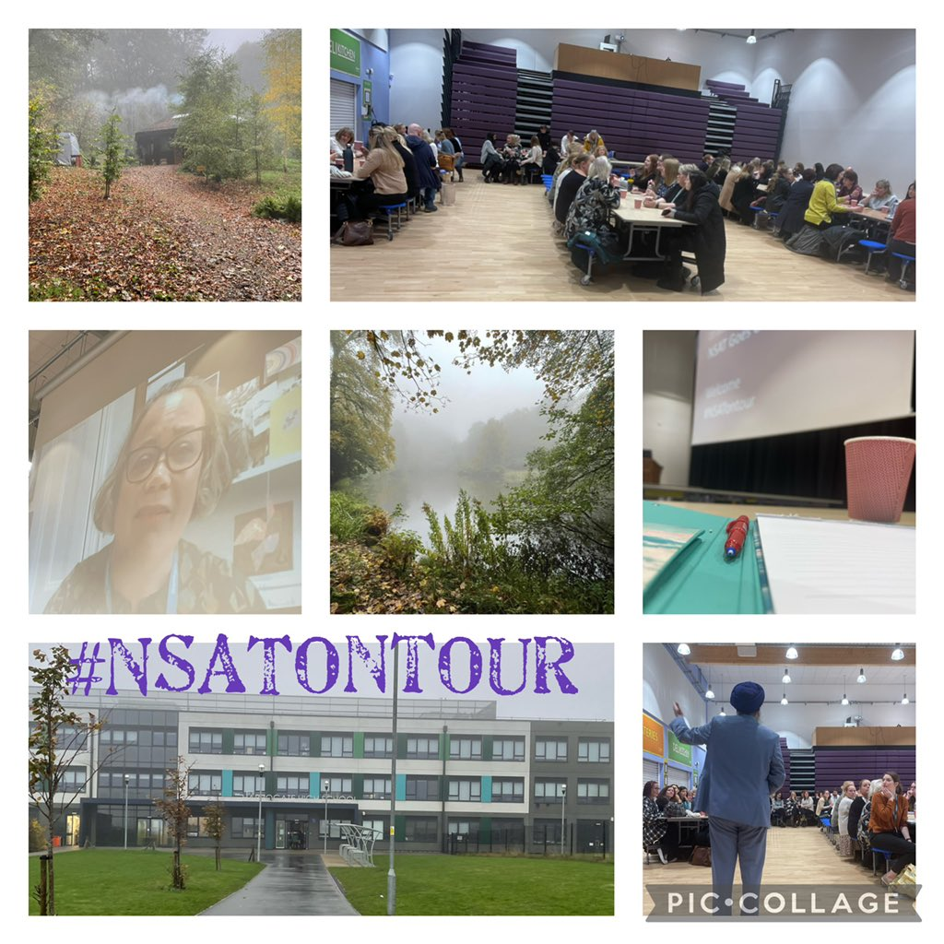
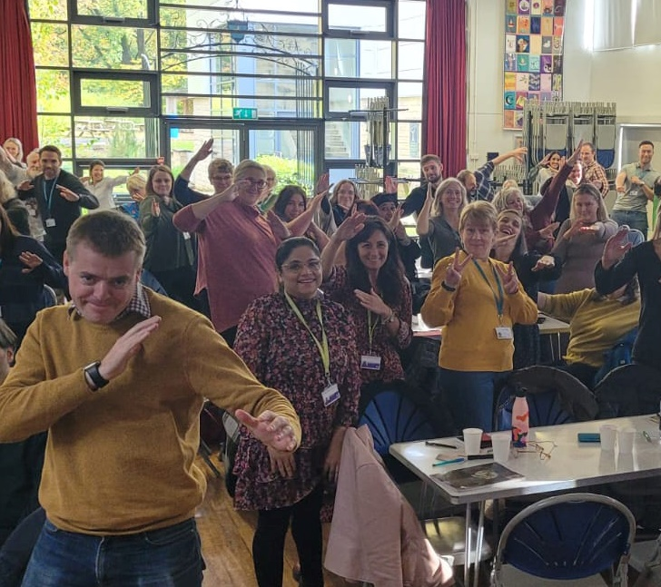
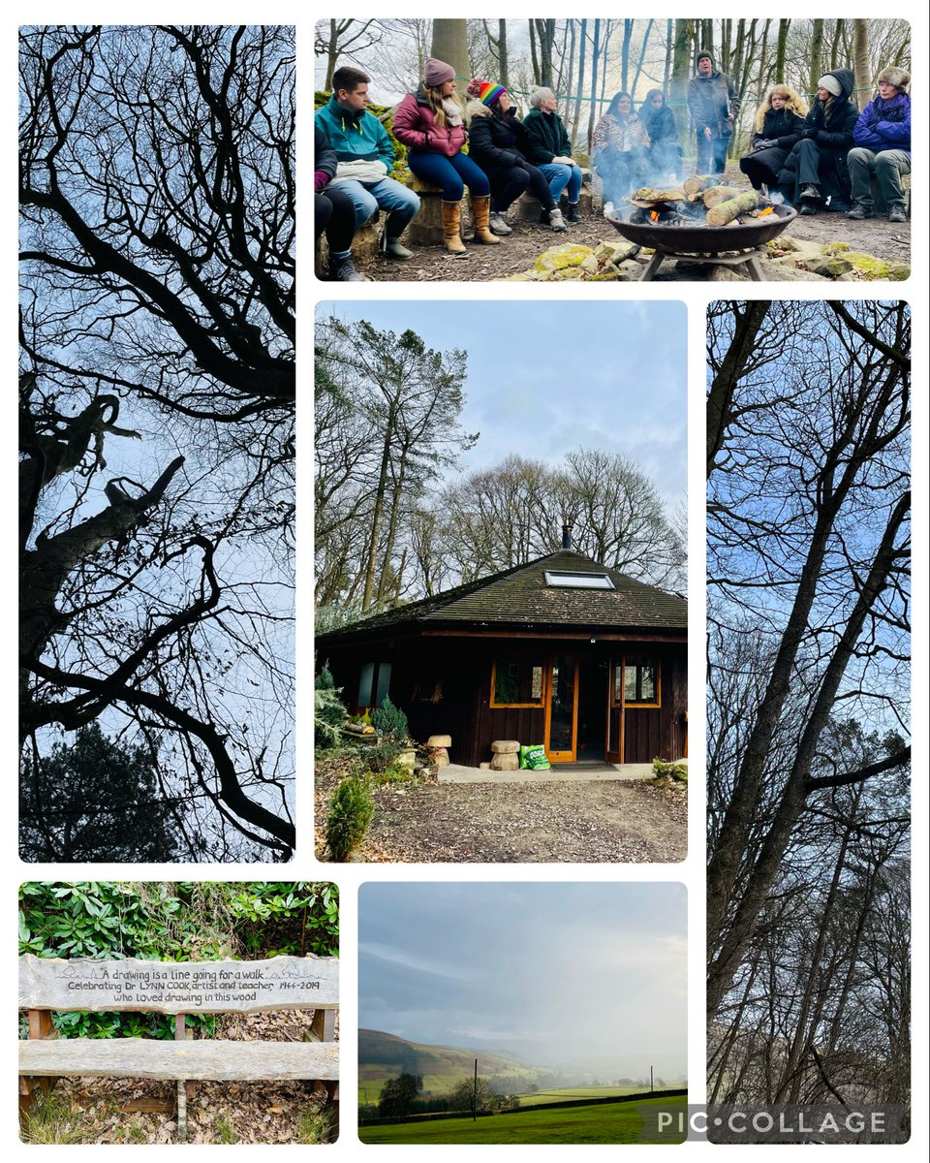
NSAT Conferences #Be more sustainable
Our annual conferences are for everyone who works in our Trust. In 2021 we focused on Environmental Sustainability and climate change education. In 2022 we went out on tour, putting on events across several NSAT schools with the theme #BeMoreSustainable

Slide 8
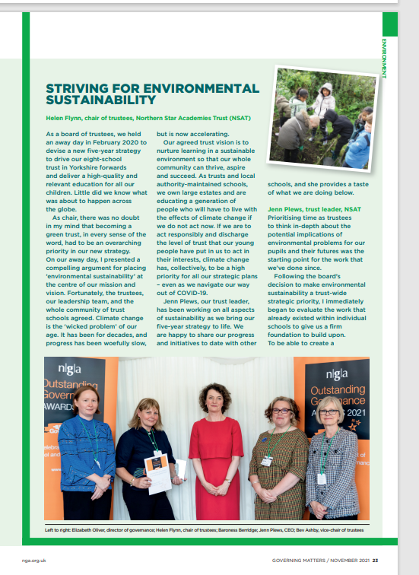
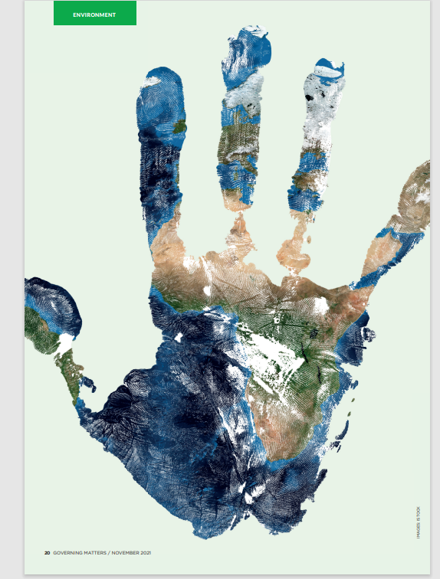
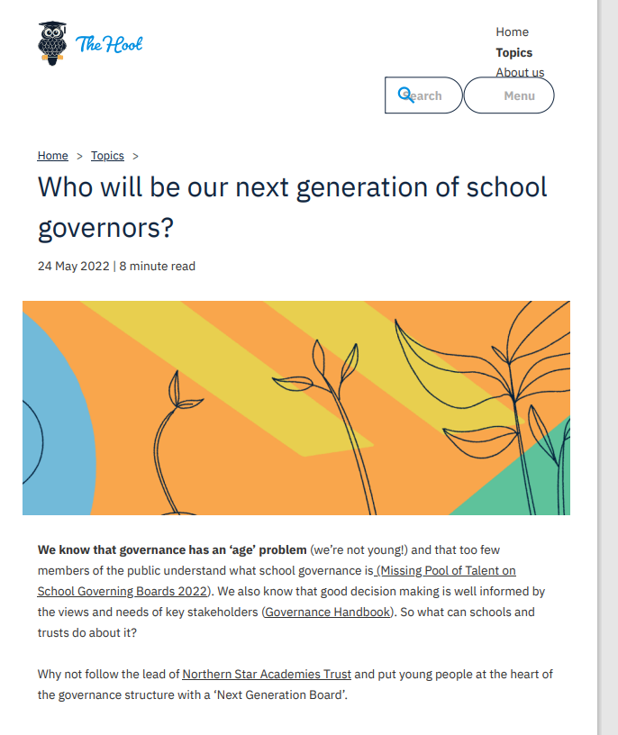
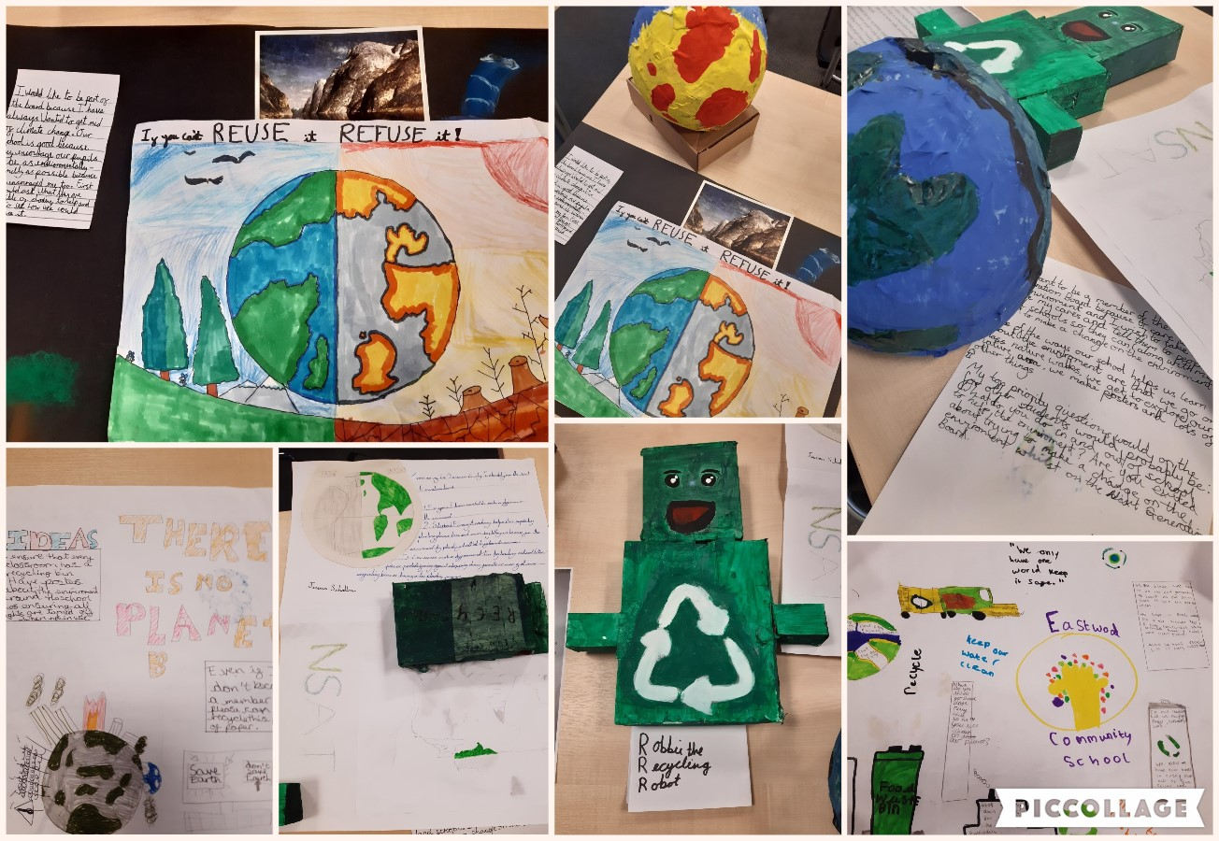
Next Generation Board & #GreenerGovernance

Slide 9








Green Futures Board
Our Green Futures Board brings together teachers and leaders who represent the schools in our Trust Partnership.
Through the work of the group our aim is to equip all school leaders, teachers and associate staff with the knowledge and skills to support children and young people understand climate change and take considered actions to protect the environment.
Colleagues on the Green Futures Board are fully empowered to explore and develop their own expertise in relation to climate change education and sustainability – creating momentum and pace in their own schools, testing, and experimenting with innovative ideas and working to ensure that organisational culture shifts to place sustainability at the heart of school improvement
Civic Partnerships

Slide 10

Climate change education
All children and young people are equipped with the knowledge and skills to address climate change
There should be equitable and universal access to climate change education so that every child and young person is prepared for climate change
Future generations should be able to navigate the complex interplay between scientific, environmental, societal and economic factors associated with climate change.
Climate Adapted Pathways in Education

Slide 11
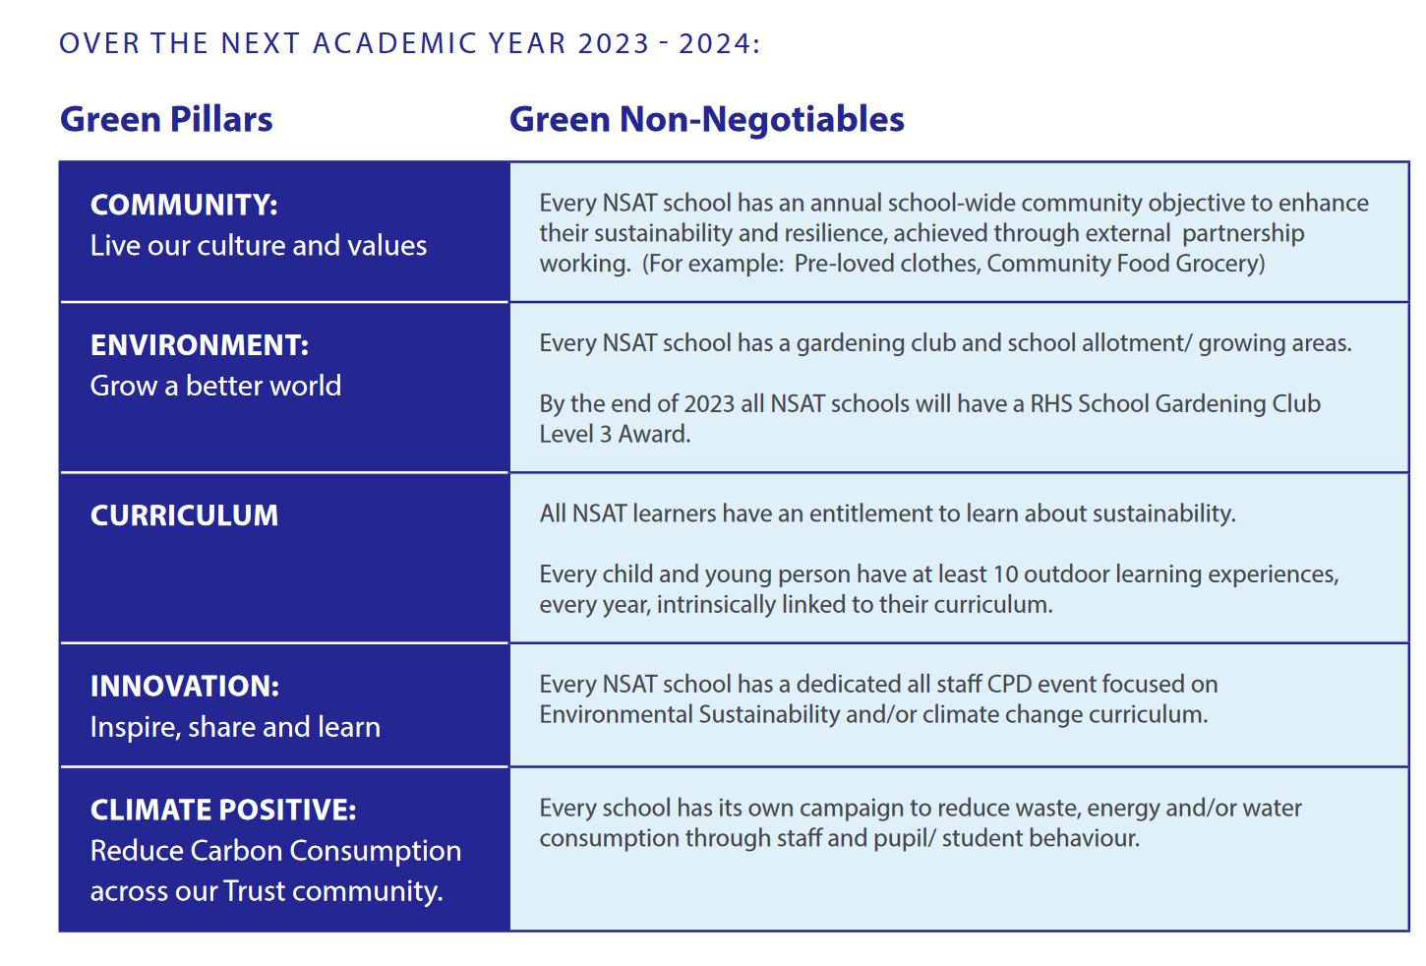
Green Non-Negotiables

Slide 12
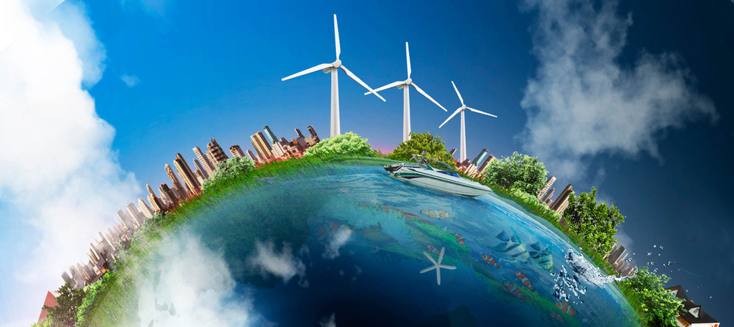

Reflective questions:
How might your trust’s approach to climate change be aligned to your wider strategic direction, priorities and purpose for education?
What steps could you t
How might you integrate and sustain climate change education into teaching and school life across your trust?

Slide 13

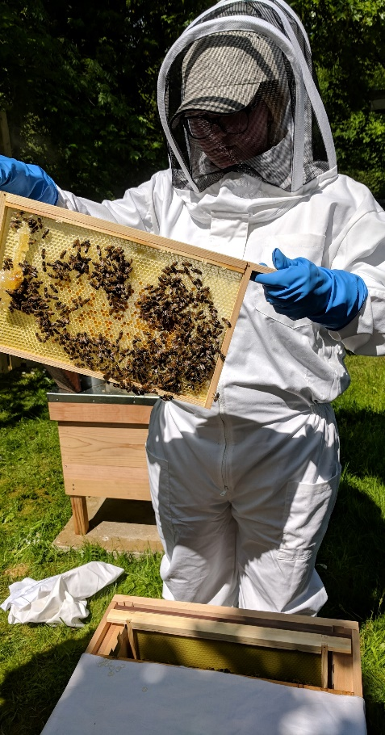
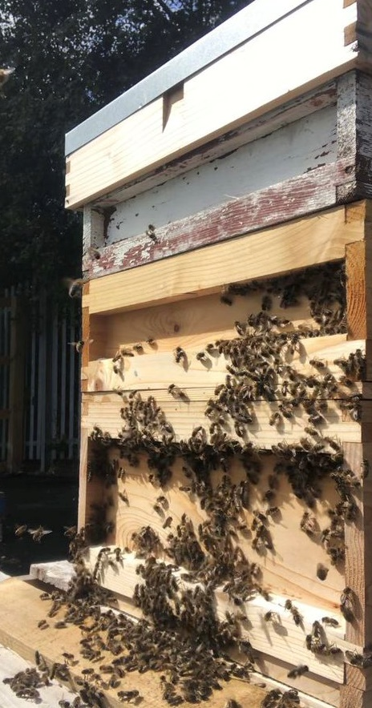
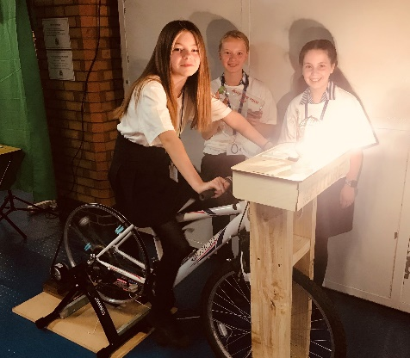
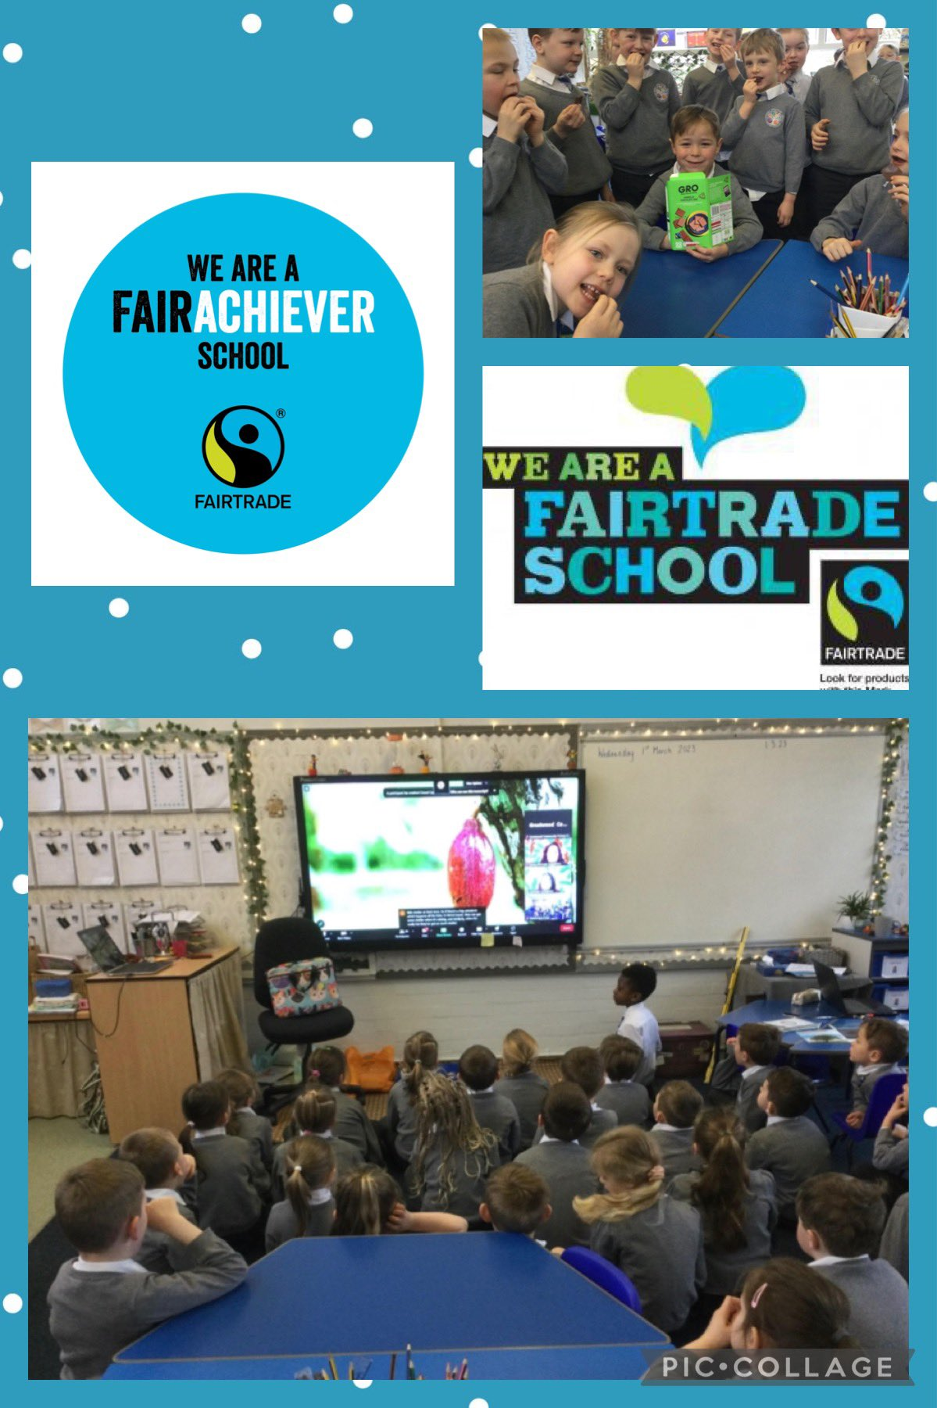
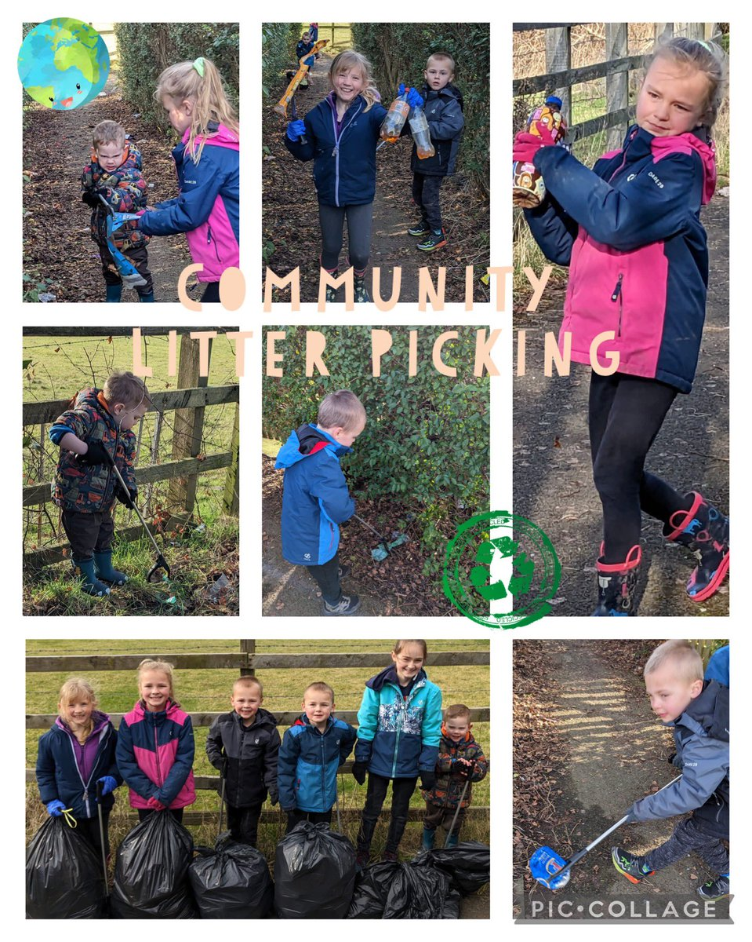
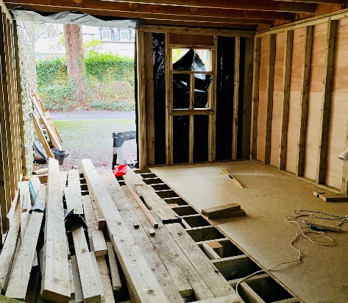
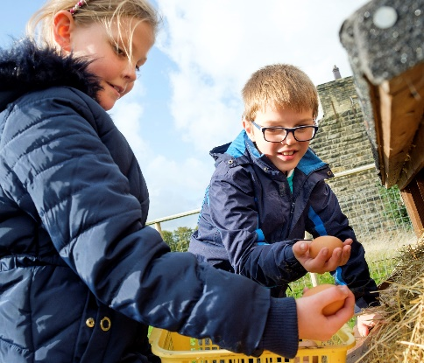
Curriculum entitlement
‘If we don’t, who will?’
Our ‘Engineers of the Future’ and their ‘Generate Gym’
^{Our farms and allotments}
^{Our apiaries}

Slide 14
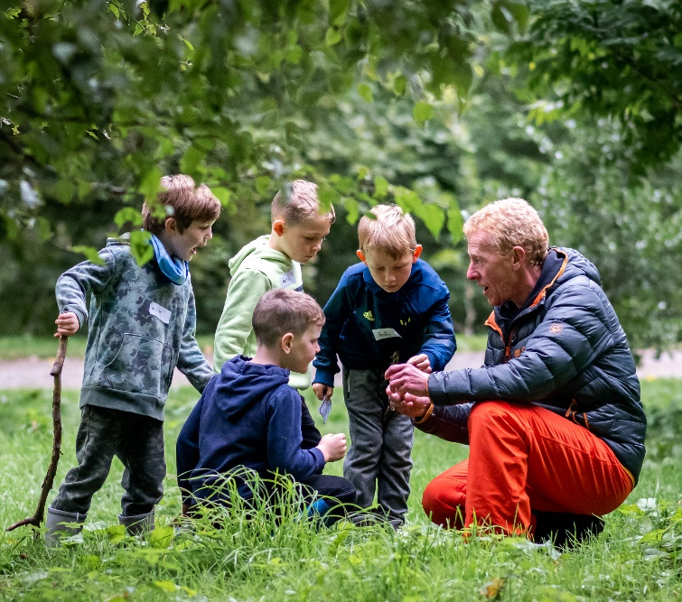
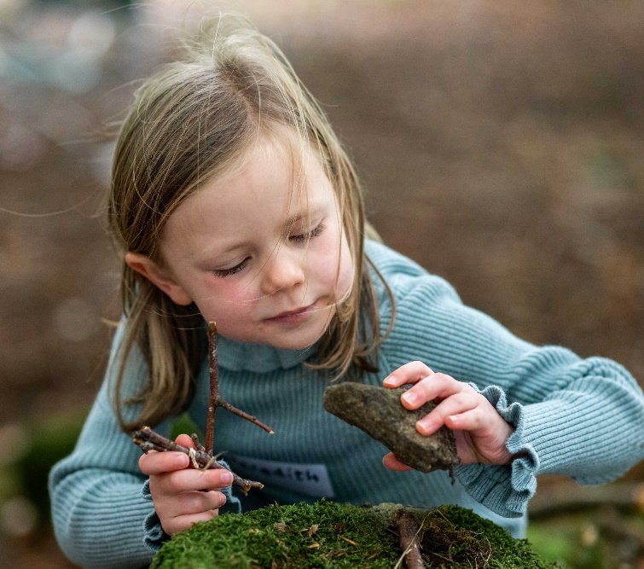
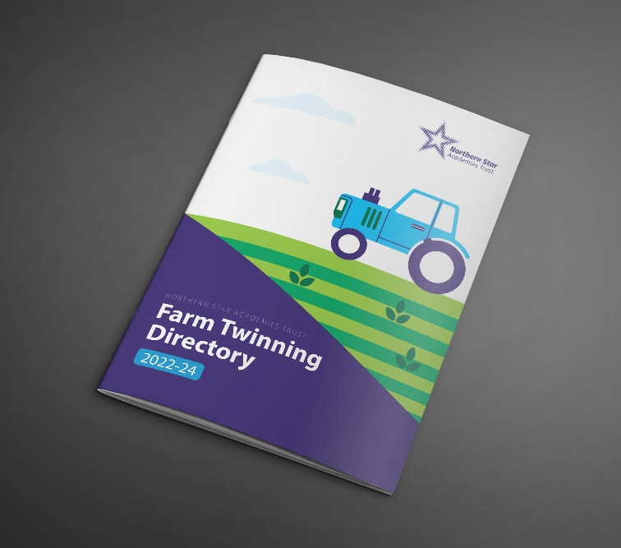
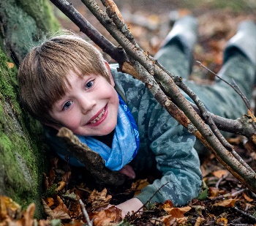
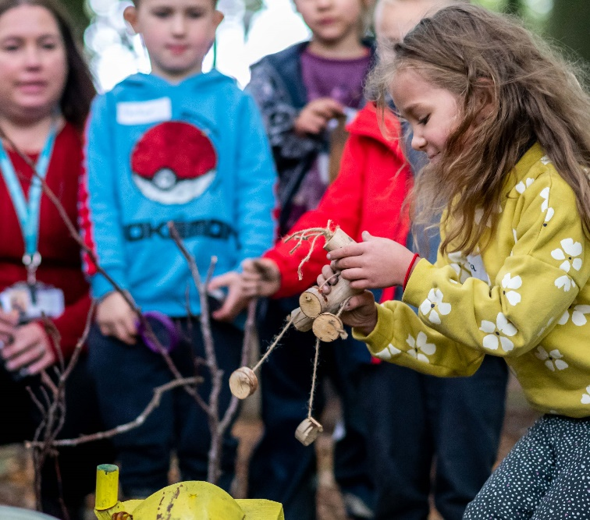
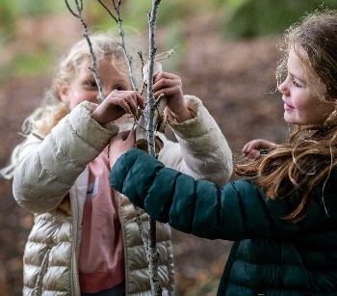
Learning in Protected Landscapes
A unique and innovative partnership between NSAT and DEFRA through Nidderdale AONB Farming in Protected Landscapes programme.
Click here for our Farm Twinning Directory:
www.nsat.org.uk/seecmsfile/?id=6158
#Year of Waste
#Year of Growth
#Year of Energy

Slide 15










Our Green Curriculum Promise
Carefully chosen Green Quality Marks have supported our continual school improvement.

Slide 16
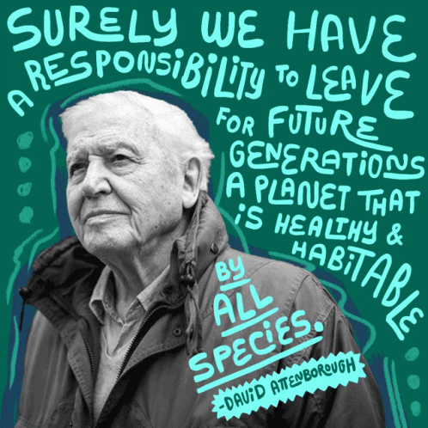
Contact Us: @NSATgreen

